Slide 1
How I spent my first month with no outside contact
March/April 2020

Slide 2
The Covid Collection

Slide 3
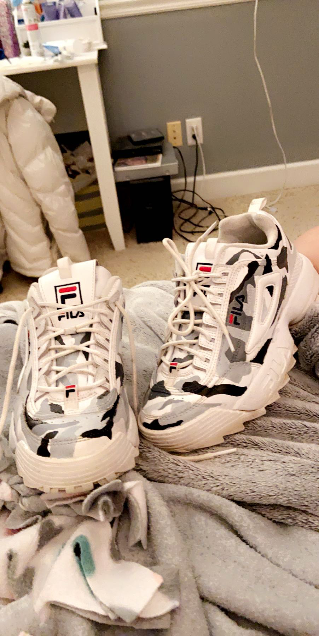
March 22, 2020
As boredom set in, I found projects to pass the time such as this pair of shoes that I refurbished to be grey camo

Slide 4
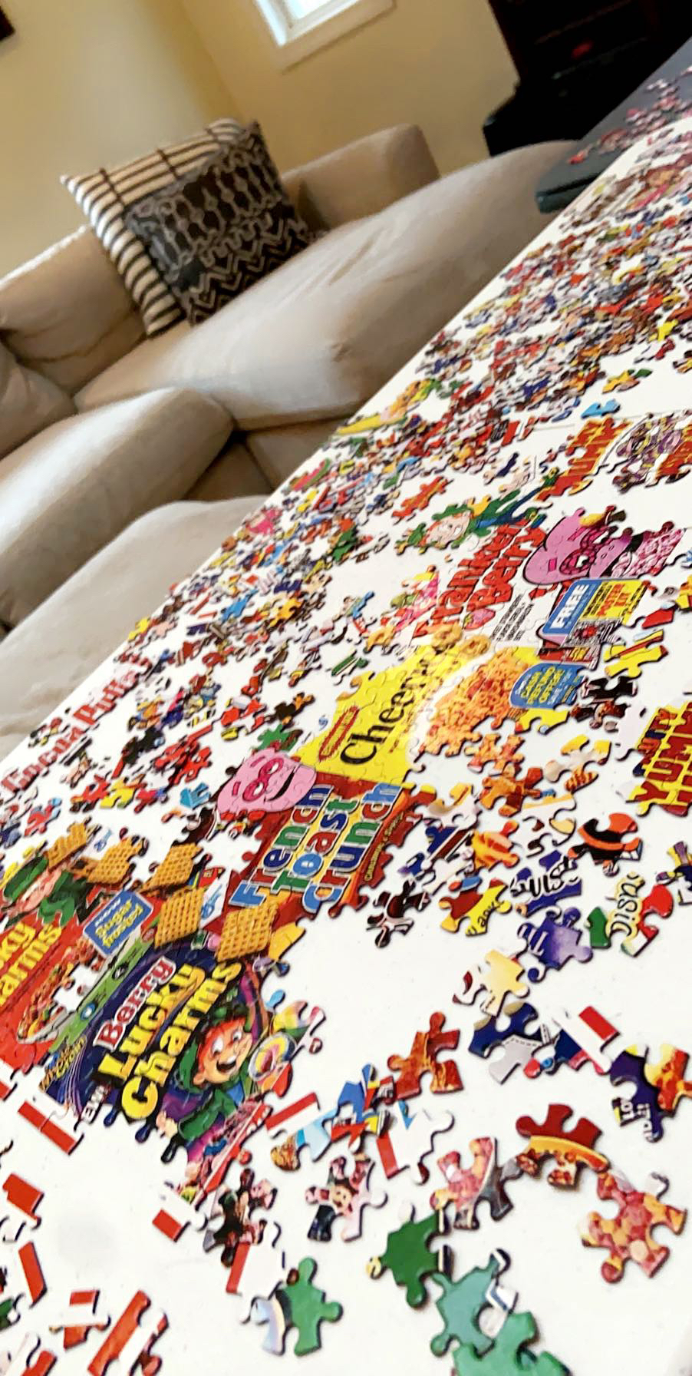
March 26,2020
Puzzles took up plenty of time for so many people that the price of them skyrocketed and many sold out quickly(we finished on March 30th)

Slide 5
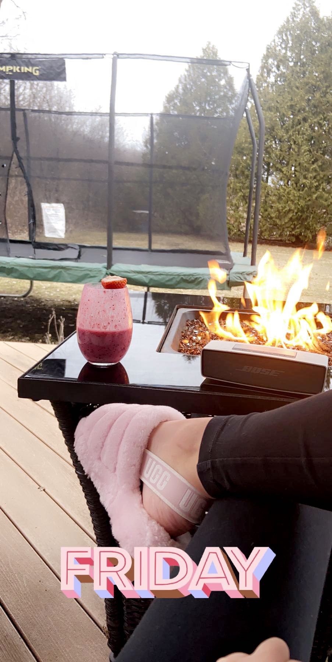
March 27,2020
Mankato, Minnesota weather started looking up early for us that year so we spent most days outside with campfires and music!

Slide 6
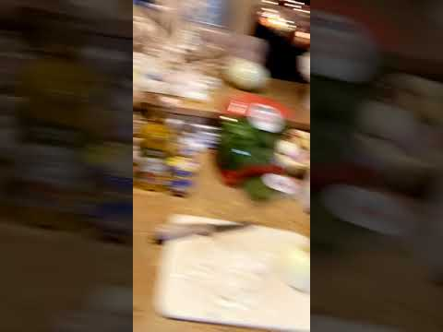
We experimented with new recipes and food
March 29,2020

Slide 7
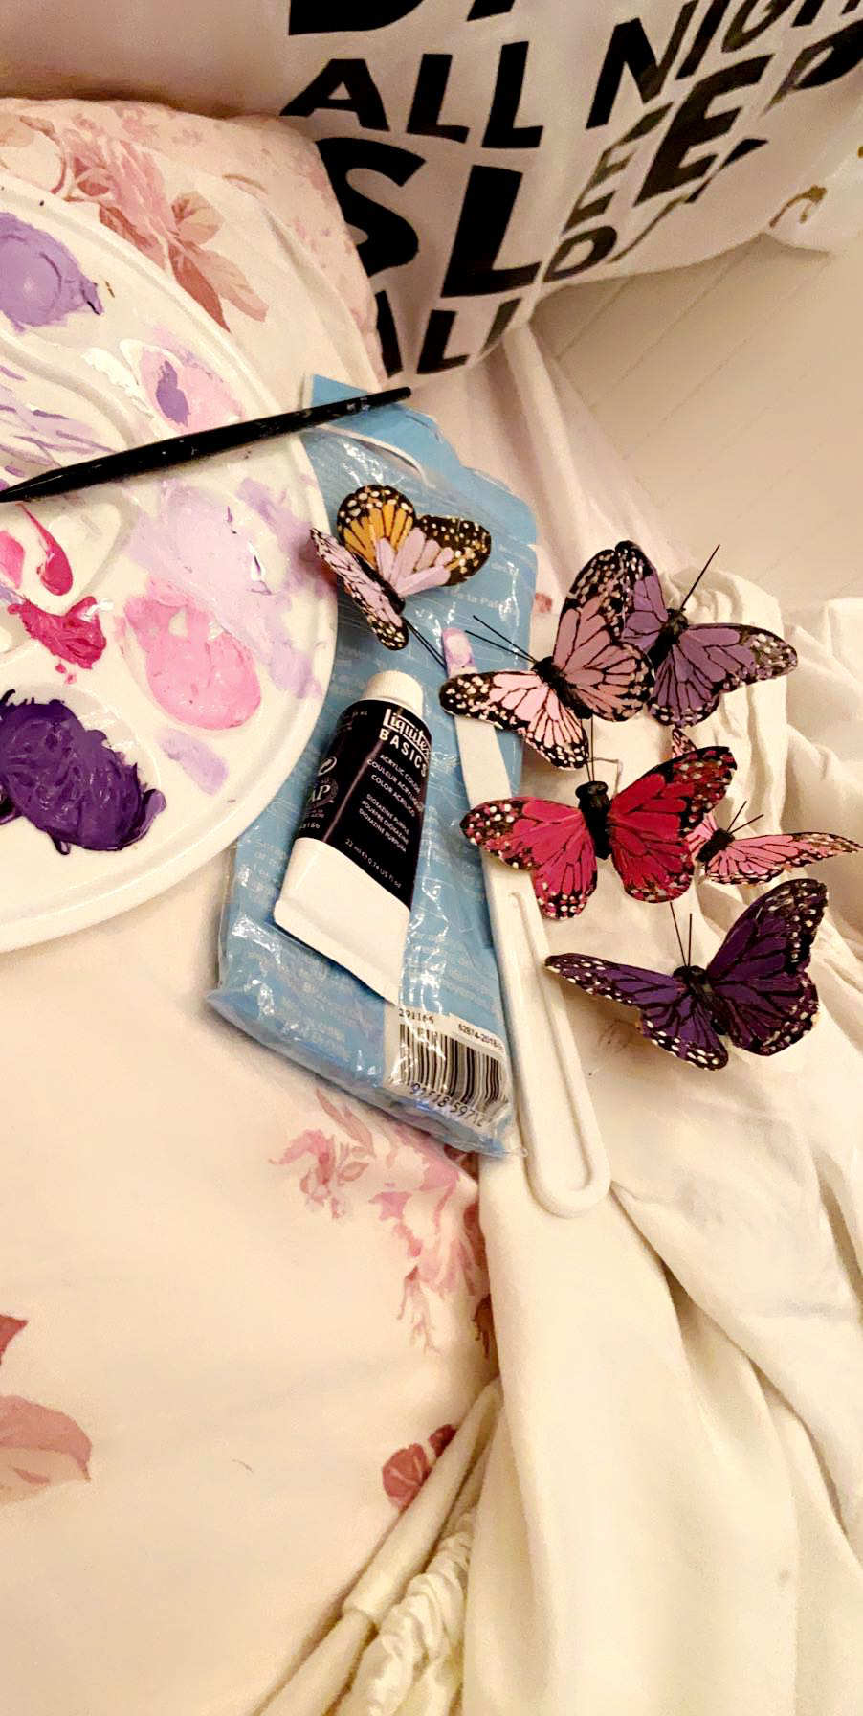
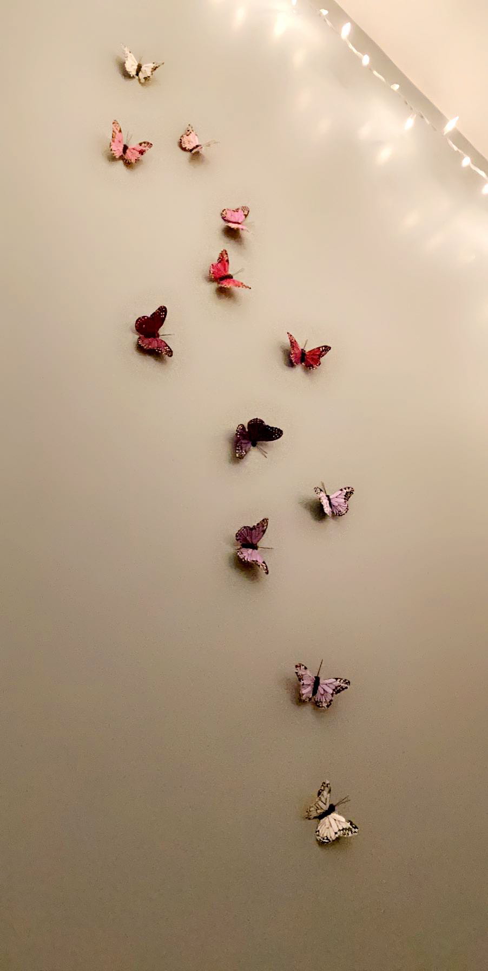
March 31,2020
Some more arts and crafts for room renovations
April 1,2020
Added the finished product to my wall

Slide 8
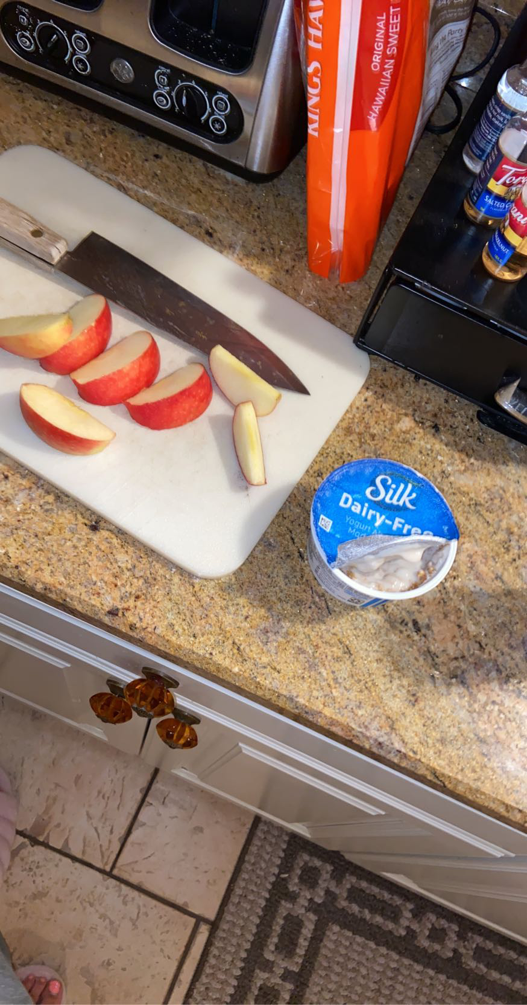
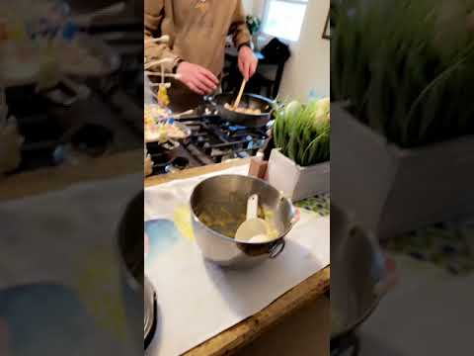
April 3,2020
April 5, 2020
I had to document my snacks of course
More cooking with my family

Slide 9
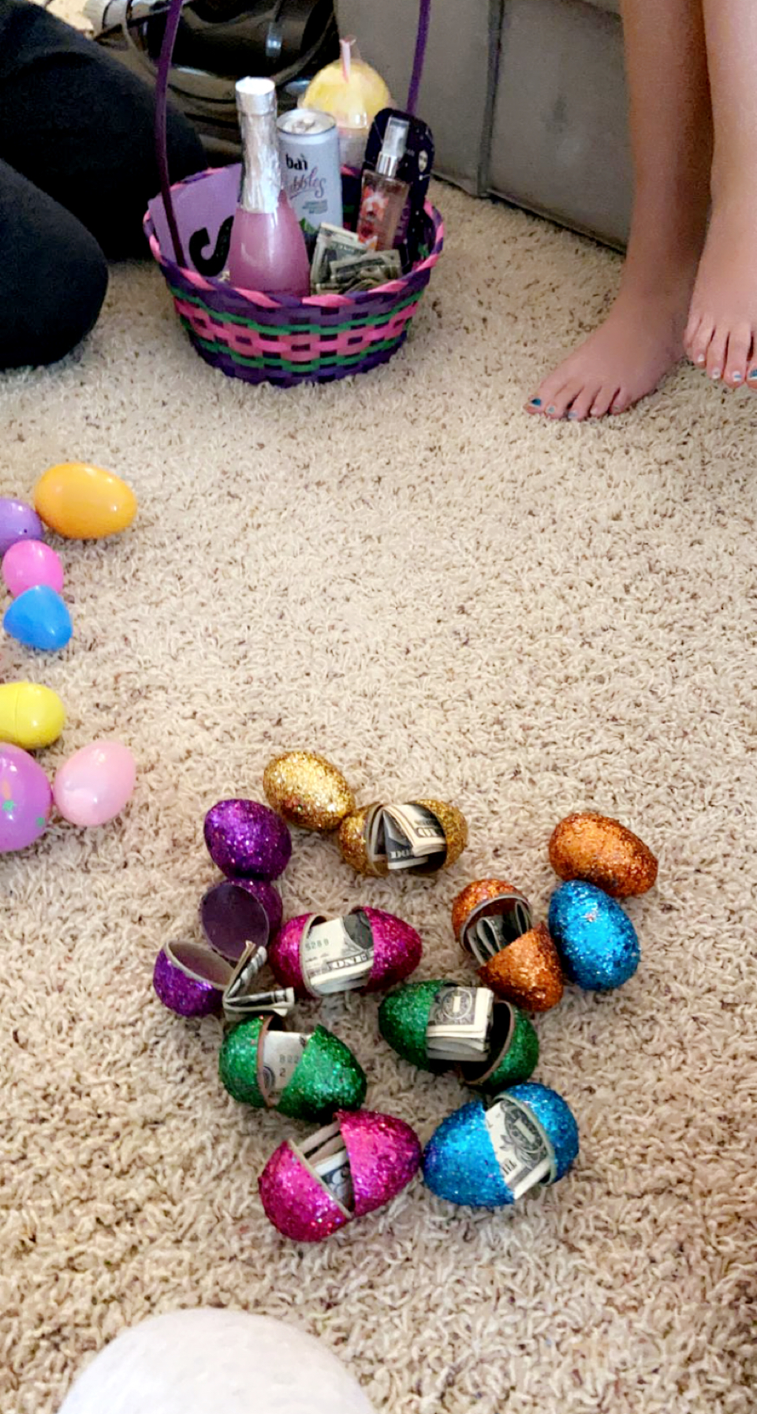
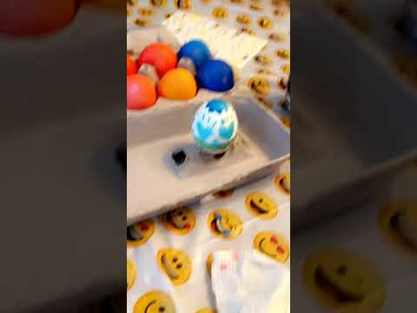
April 12,2020
Had an Easter egg hunt and dyed Easter eggs at home
We chose to keep to our immediate family to keep ourselves and them safe which was the first time we’ve spent Easter alone since I’ve been born.

Slide 10
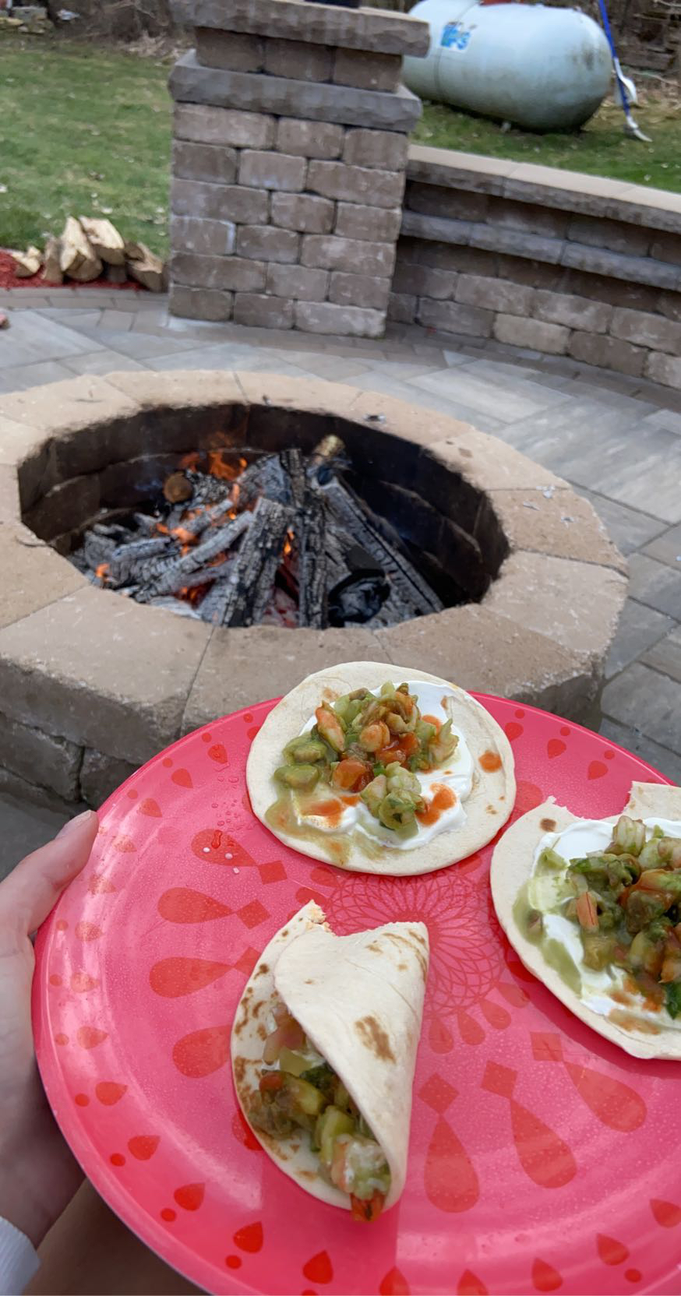
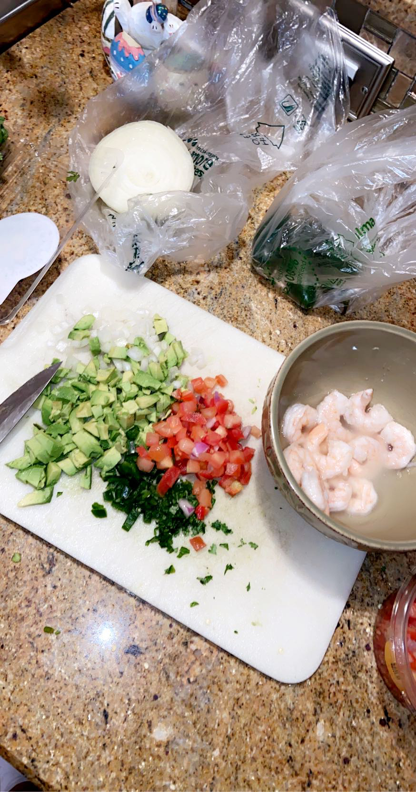
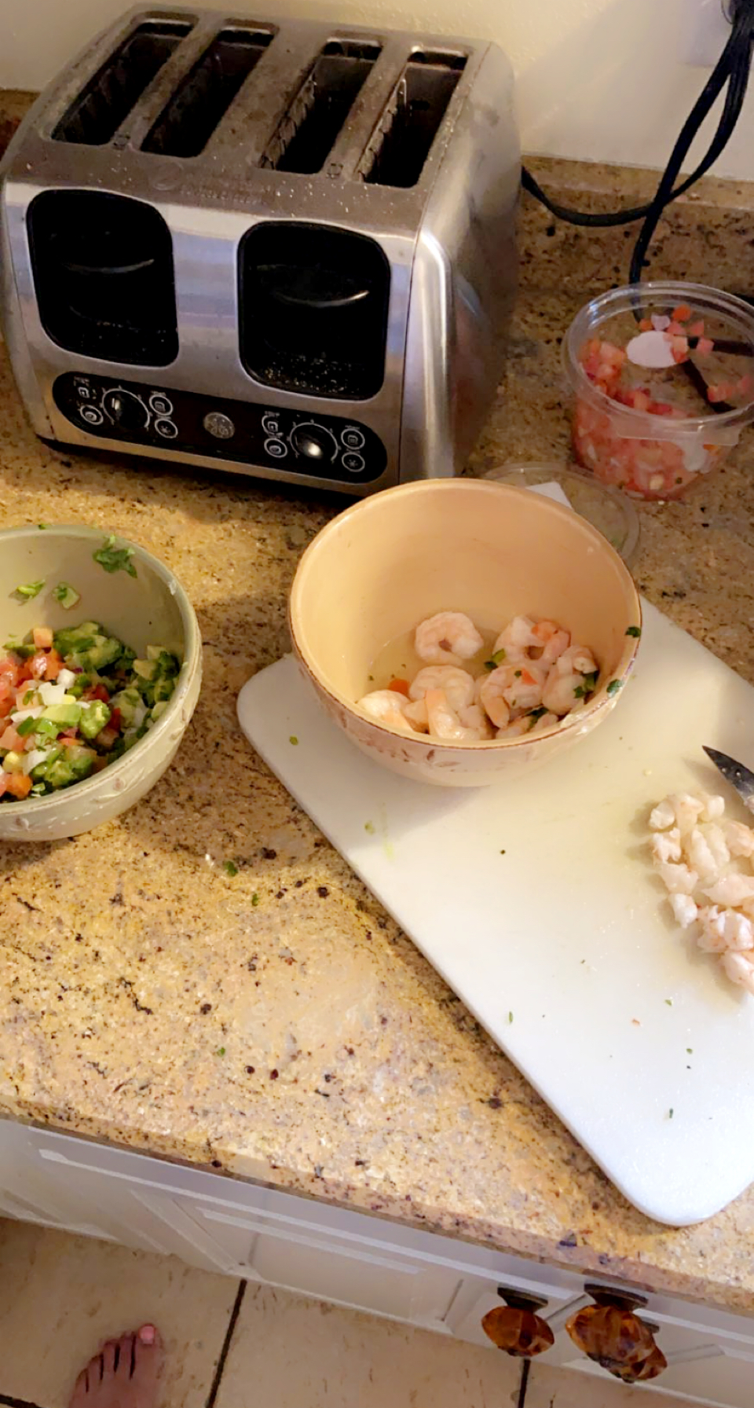
April 16,2020
I made ceviche for the first time, originating from Peru!
And put it into tortillas!
Loved it so much I had to make it again- April 21
April 22

Slide 11
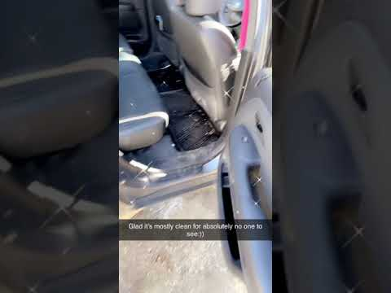
April 19,2020
Spring cleaning- Took all the old garbage and clothes out of my car from the past few months
Not that anyone would be in my car for awhile...

Slide 12
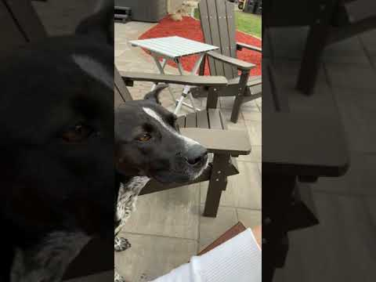
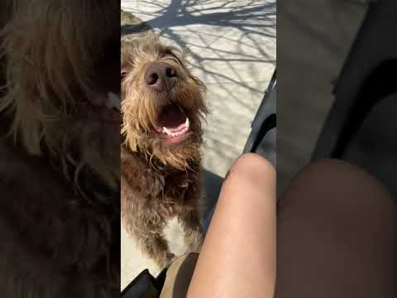
April 22,2020 The end of the first month
Although it went on for longer, this series ends on Earth Day!
Celebrated with a campfire, smores, and golf cart rides that led us to a cute puppy

