Slide 1
18 months in a pandemic
By Jeremiah Coey

Slide 2
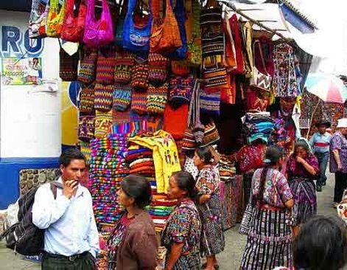
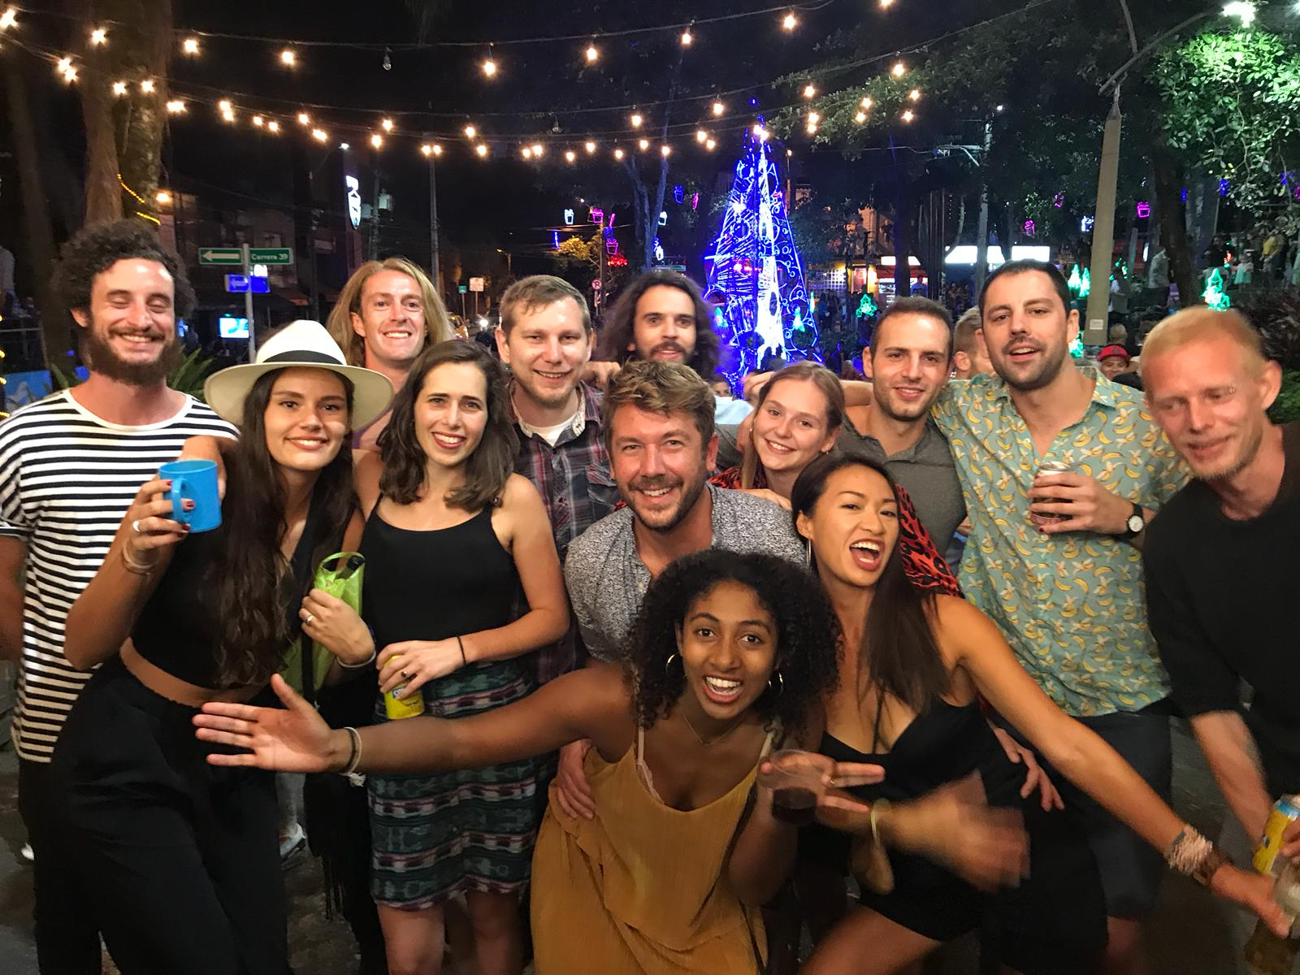
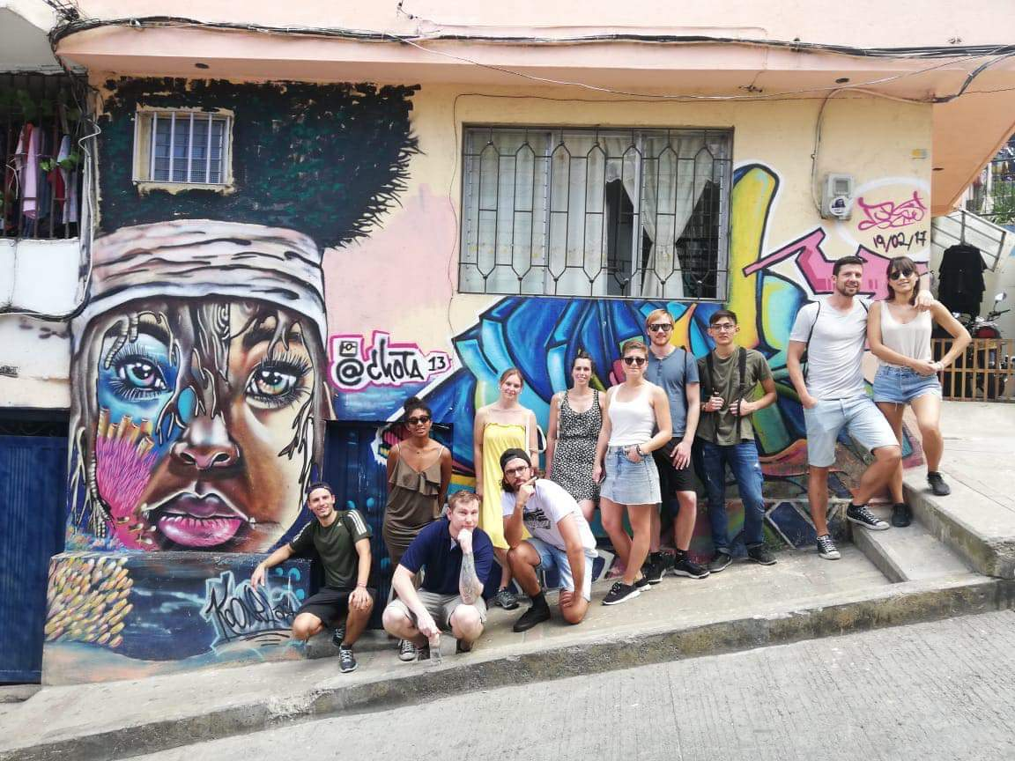
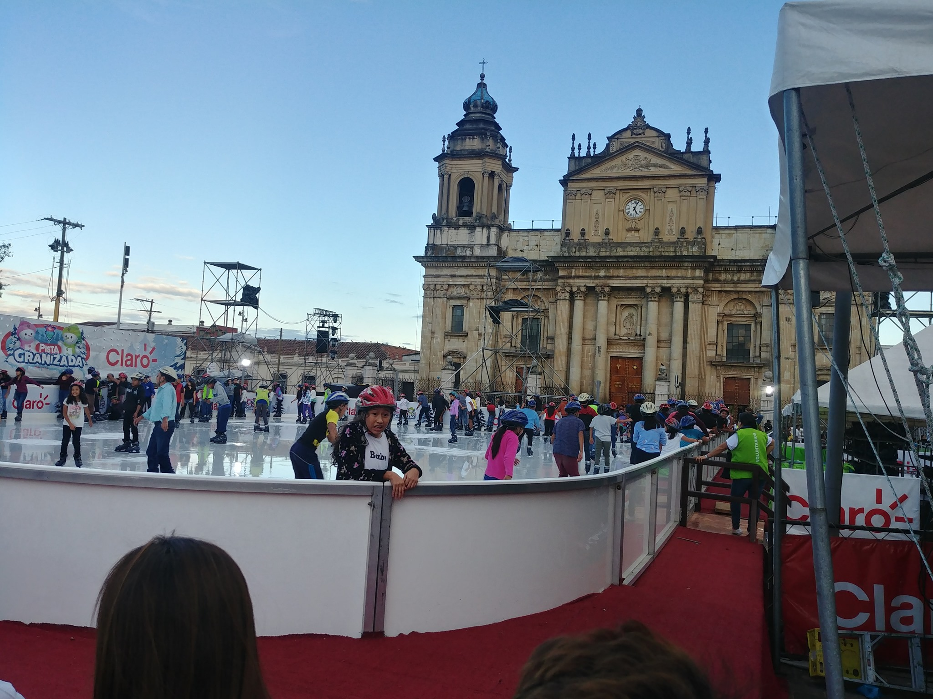
December 2019 “Viviendo la Buena Vida”
- I was traveling Guatemala and Colombia, studying the language and cultures, making friends, and living the good life.

Slide 3
January 2020 “Oh Wow, What’s This?”
- While in Colombia, the news broke of a new virus in China. As I returned home from abroad, the day I arrived was the same day the first U.S. case was discovered. The case was in Washington, and I was nowhere near there, so I was not very concerned. I began my college semester a few days later in Wisconsin.

Slide 4
February 2020 “Uncertainty”
Classes went forward, in-person, as scheduled. I was a college student myself, but I also worked in classrooms teaching English language learners, as well as a work-study in our diversity department. We were warned that classes could change at a moments notice.
Beyond the regular planning, we also had to make backup plans and communicate those plans to students and staff. This was a real challenge, especially with regular changes based on CDC reports. We made it through the month without having to change anything, but anxiety and frustration were growing from the uncertainty.

Slide 5
March 2020
“Full Stop!”
My classes and summer study abroad were canceled, my work positions were terminated, and Wisconsin issued a “Stay at home” order, closing most businesses.
My classes, my jobs, my social life, my support system... It was all at school. And it all ended abruptly.

Slide 6
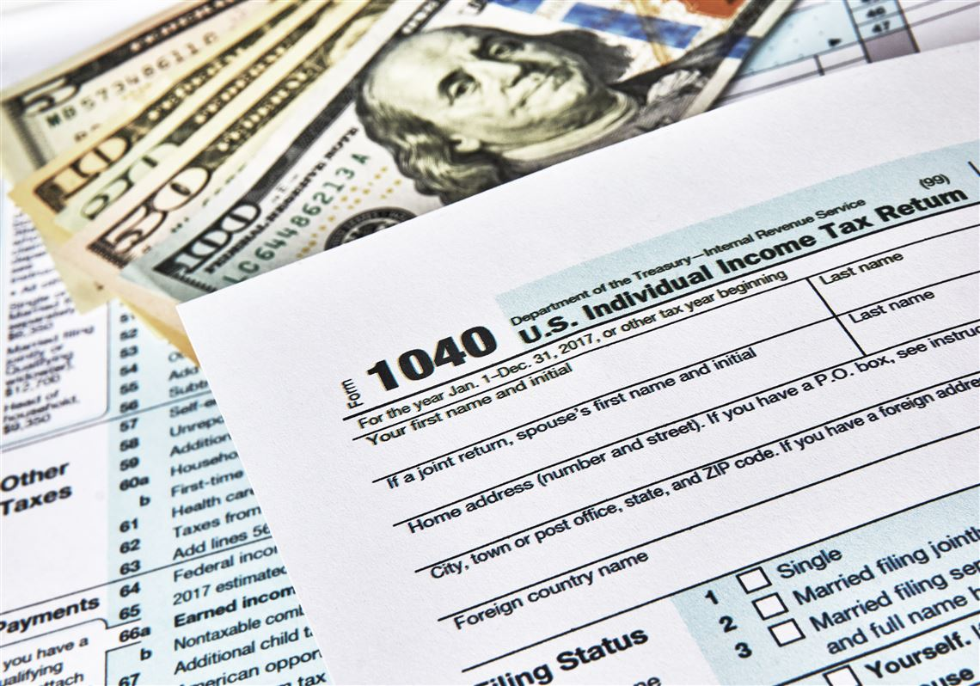
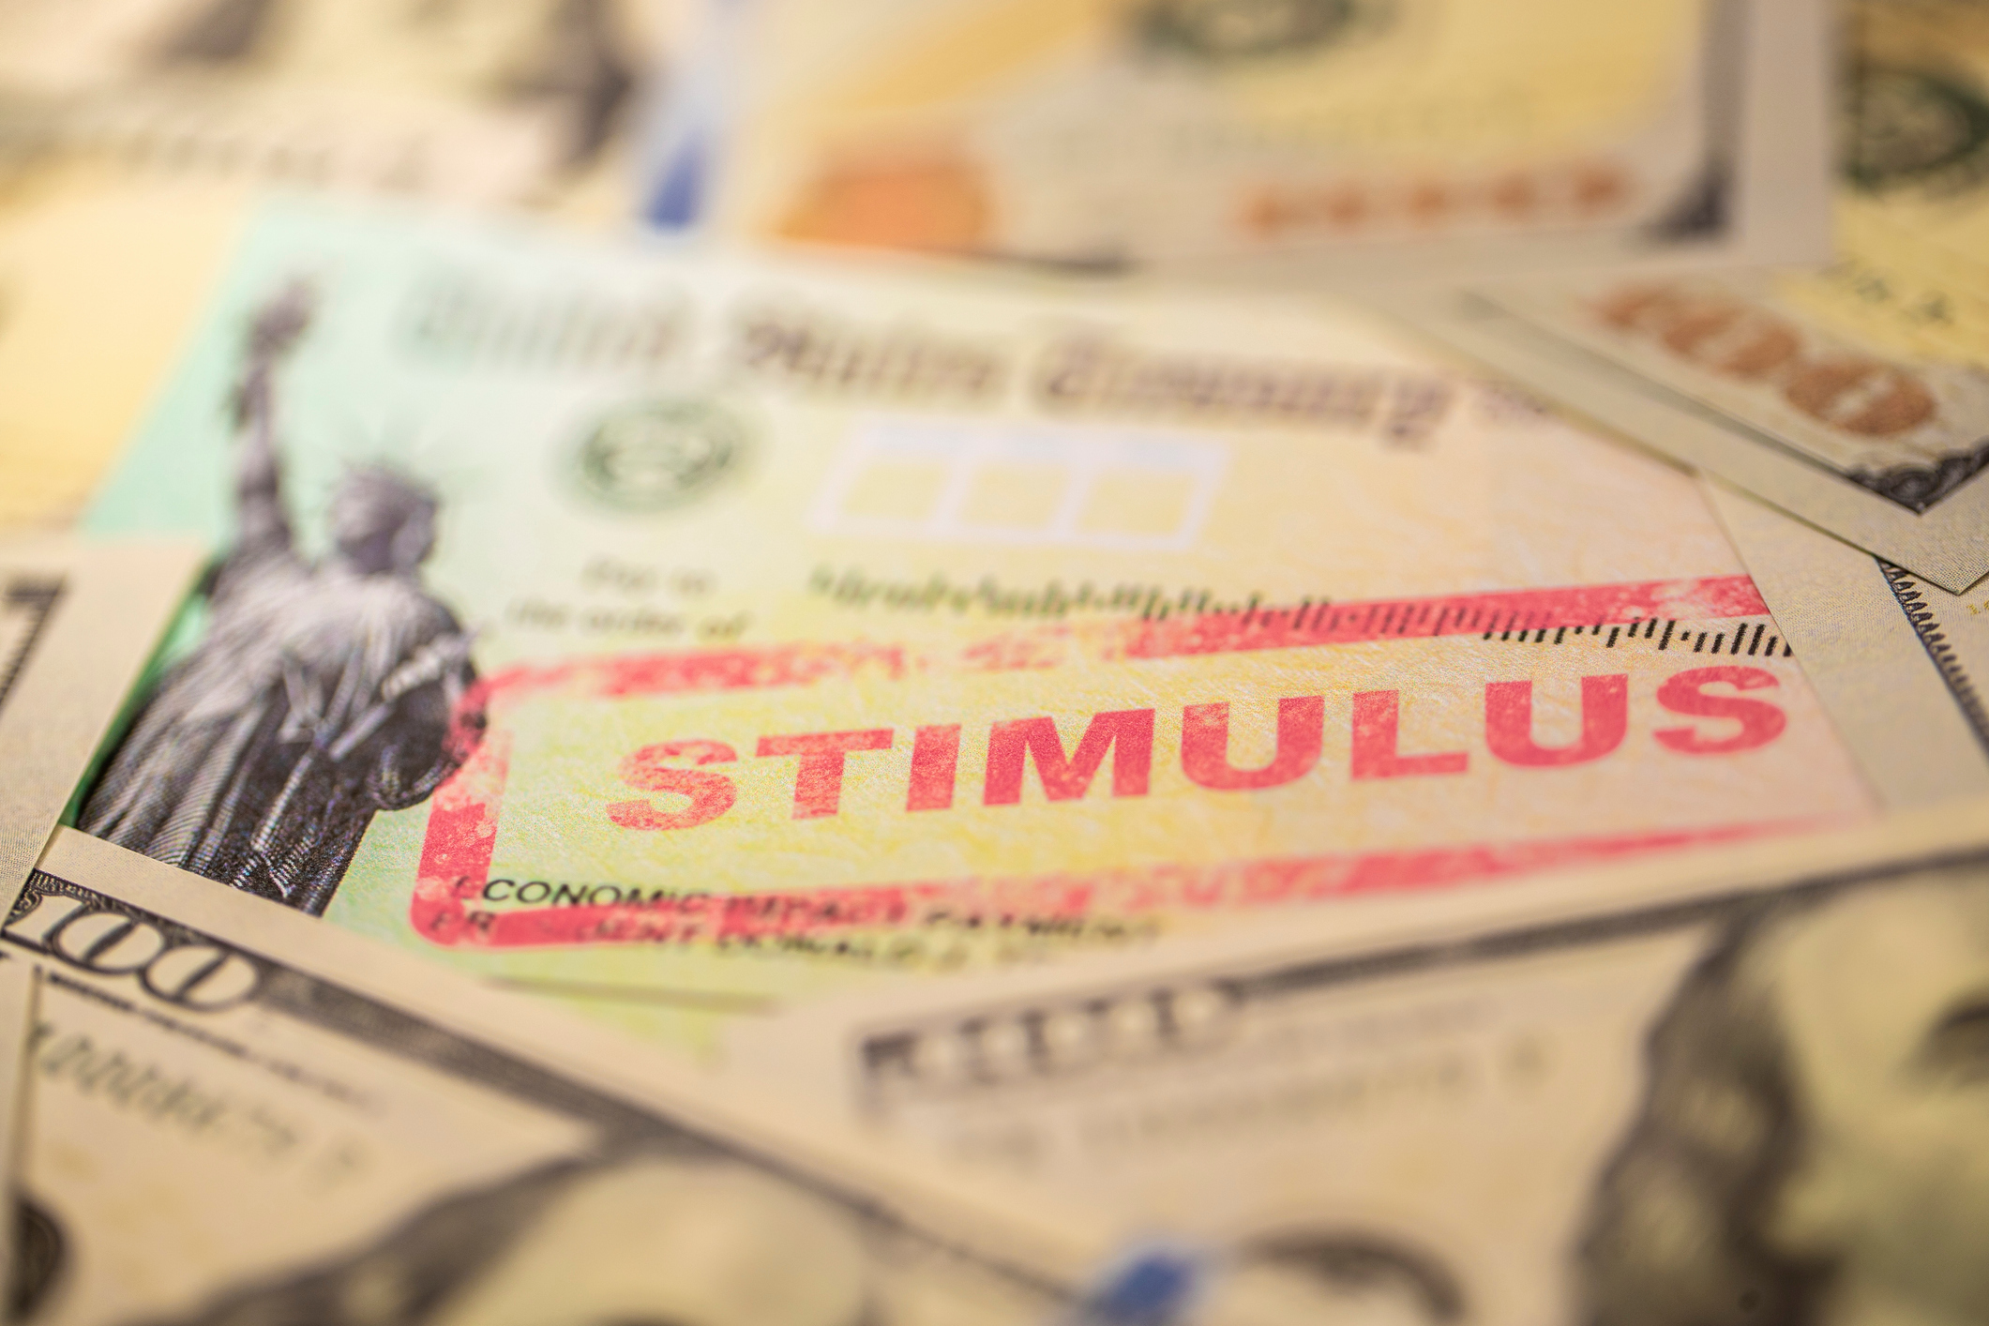
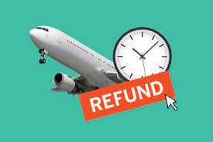
April 2020 “Safety Net”
Classes returned, but completely online. There were constant issues with communication and technology- nothing was organized, and nobody knew what was going on. It was a disaster.
This only amplified the fact that I have disabilities which make it very difficult to learn in an online format. My grades completely nosedived, and I began to think about dropping out of school.
My academic and emotional states were in shambles, but fortunately I had a financial safety net. I had some financial aid money leftover, I got my final paycheck, I received scholarship awards, my tax returns came back, I got a stimulus check, and I got refunds for my canceled summer study abroad trip. Ironically, it was the most money I had ever had in my life at once.

Slide 7
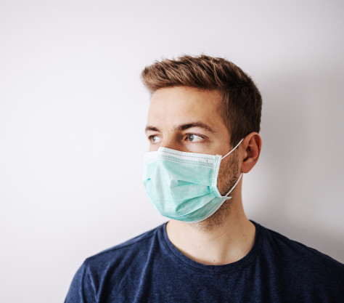
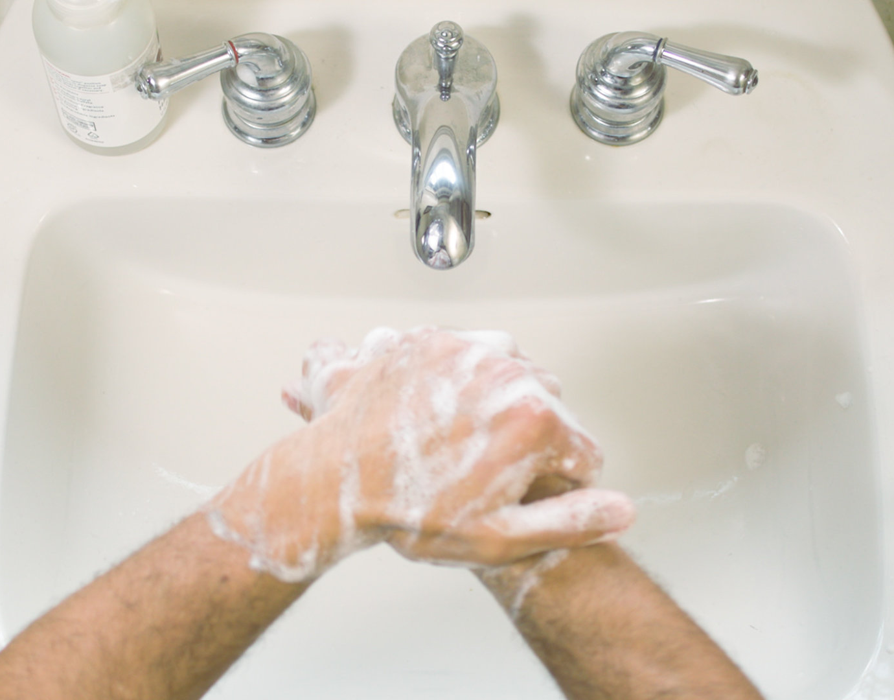
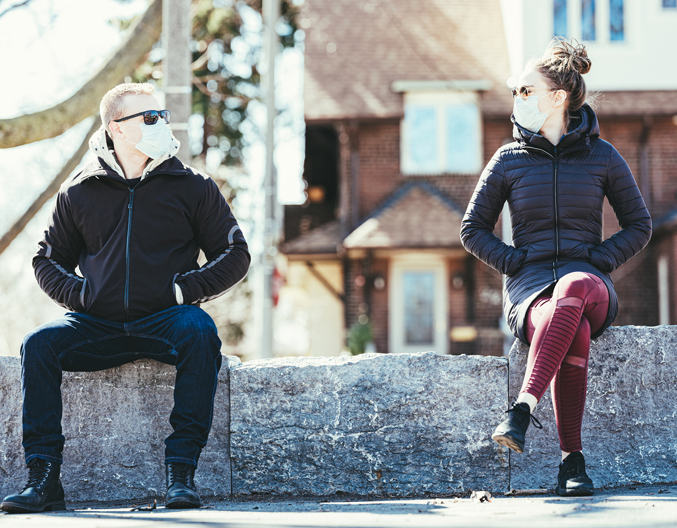
May 2020
“What’s So Difficult?!
It’s pretty simple: If everyone washes their hands, keeps their distance, and wears a mask... We can slow the spread and get this under control sooner... But instead, people are a bunch of babies whining about wanting haircuts.
Wash your hands
Keep your distance
Wear a mask

Slide 8
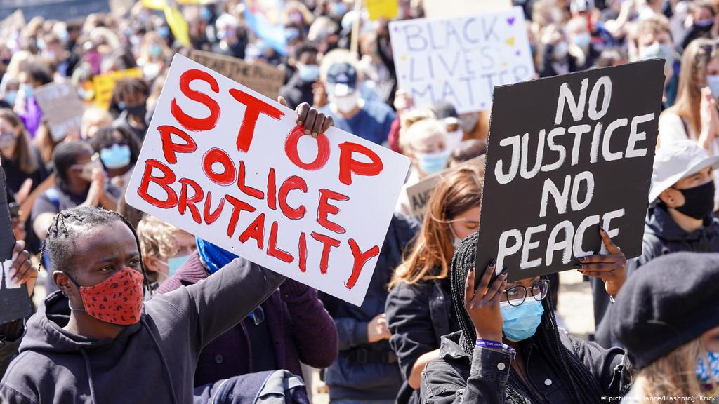
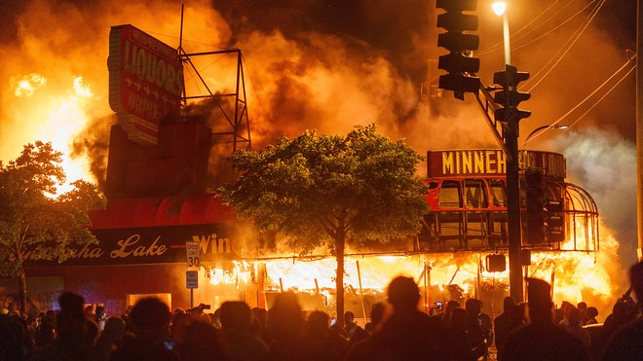
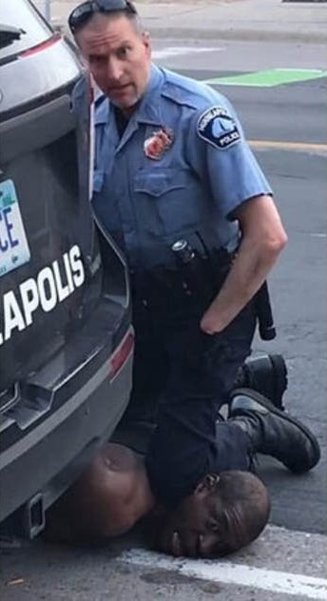
June 2020 “The Other Pandemic”
Long before the Covid pandemic, there was another pandemic in the U.S.- the diseases of systemic racism and police brutality that have plagued our nation throughout its history.
May 25th, Minneapolis police killed George Floyd. The gruesome act was caught on tape for the world to see. Protests erupted the next day and spread across the nation and around the world, with some turned into riots.
Throughout June, nearly all media coverage and social dialogue was about police brutality, racism, protests, and riots.
Covid was put on the backburner while a social revolution swept the country.

Slide 9
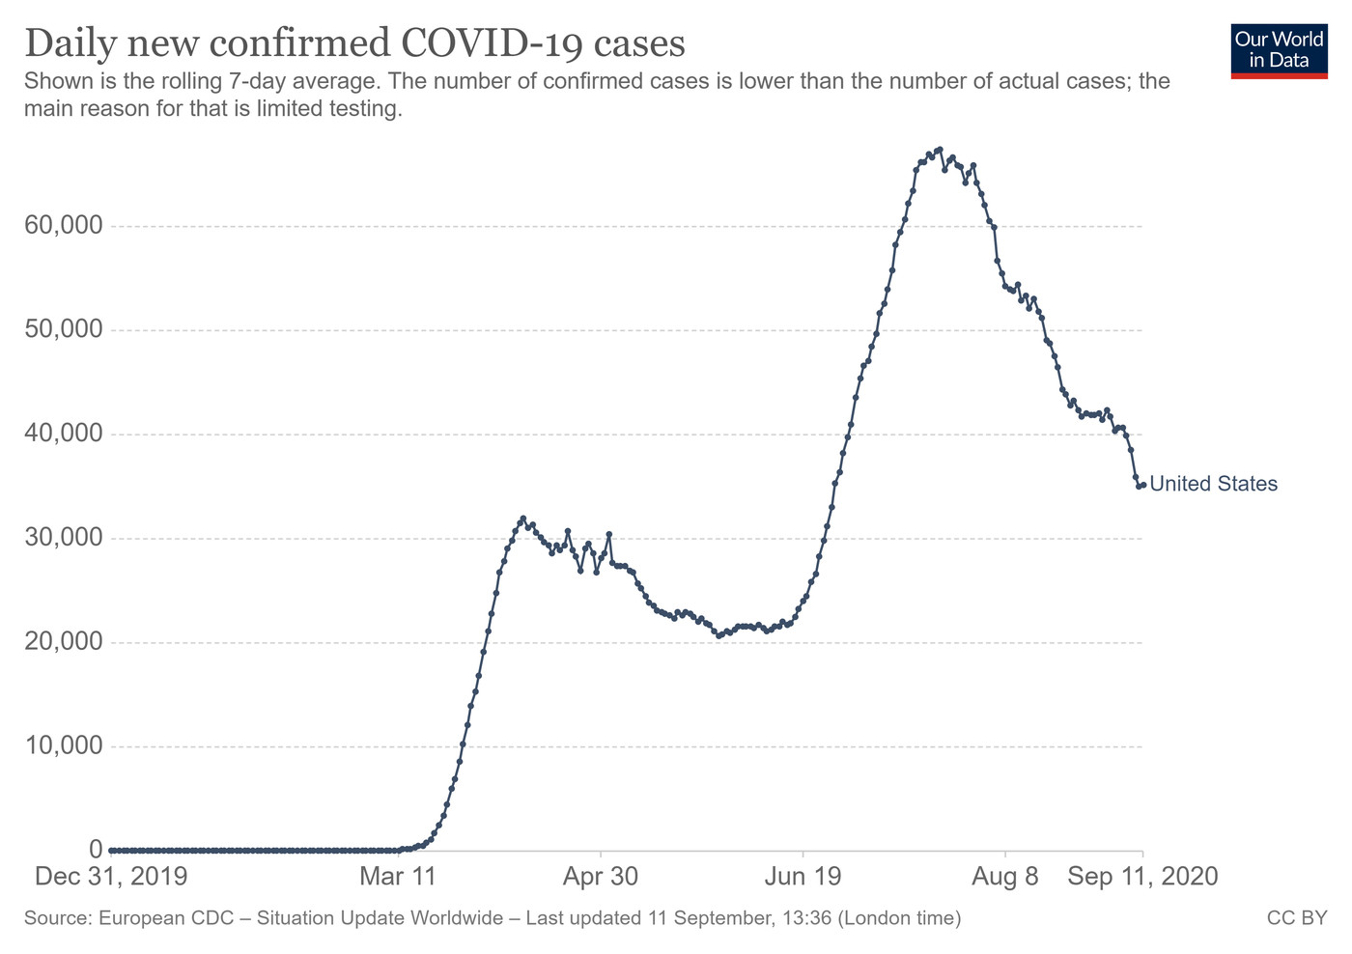
July 2020 “Look Who’s Back”
Americans went into summer fed up.
Some were fed up with racism and police brutality, so they spent weeks protesting across the country.
Others were fed up with staying home, so as states “opened up” for business and travel, people flooded the bars, restaurants, and beaches.
People also gave up on masks and social distancing. I’ve never seen the local bars as packed as I have during this pandemic once they were allowed to reopen. Every bar I’d pass would have an overflowing parking lot all summer.
...And Covid soared to new heights.

Slide 10
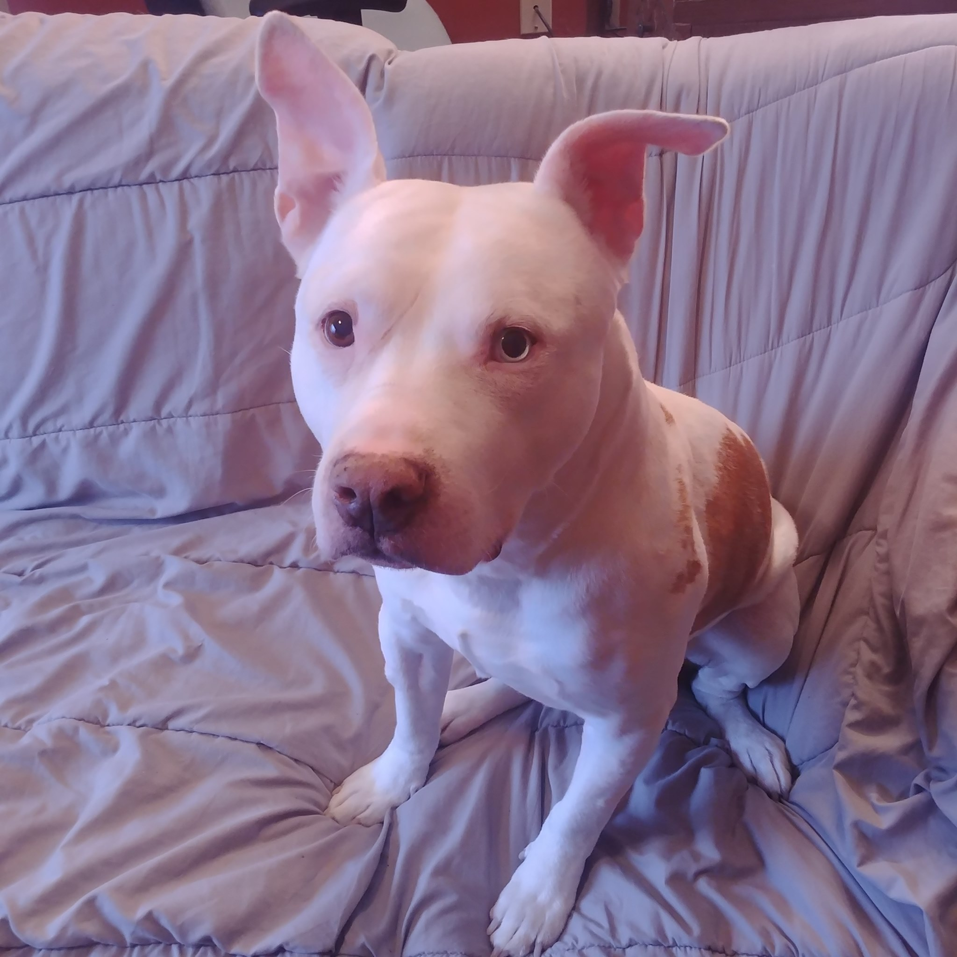
August 2020 “Changing Places & Familiar Faces”
After 5 months of isolation, things relaxed a bit and I met up with people for the first time since classes were suspended. I spent a weekend with my family, whom I hadn’t seen in a year. I also brought a new addition home- my aunt gave me her dog to come live with me, which was exciting for both him and I.
I had been talking and texting with someone for a few months and we were finally able to meet up in person. We began “officially” dating soon after.
I also moved to Eau Claire and transferred to the university from the technical college, which was exciting.
Things were finally looking up and I was excited for the future.

Slide 11
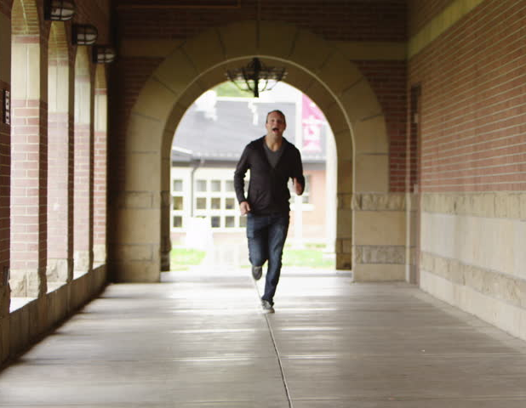
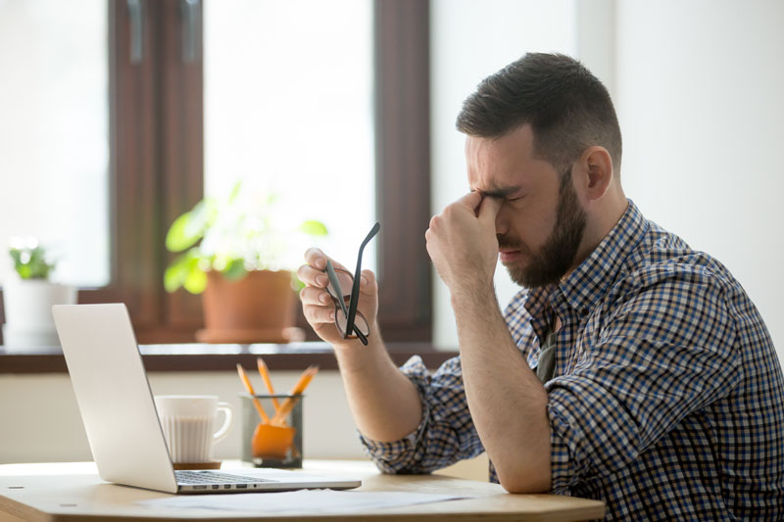
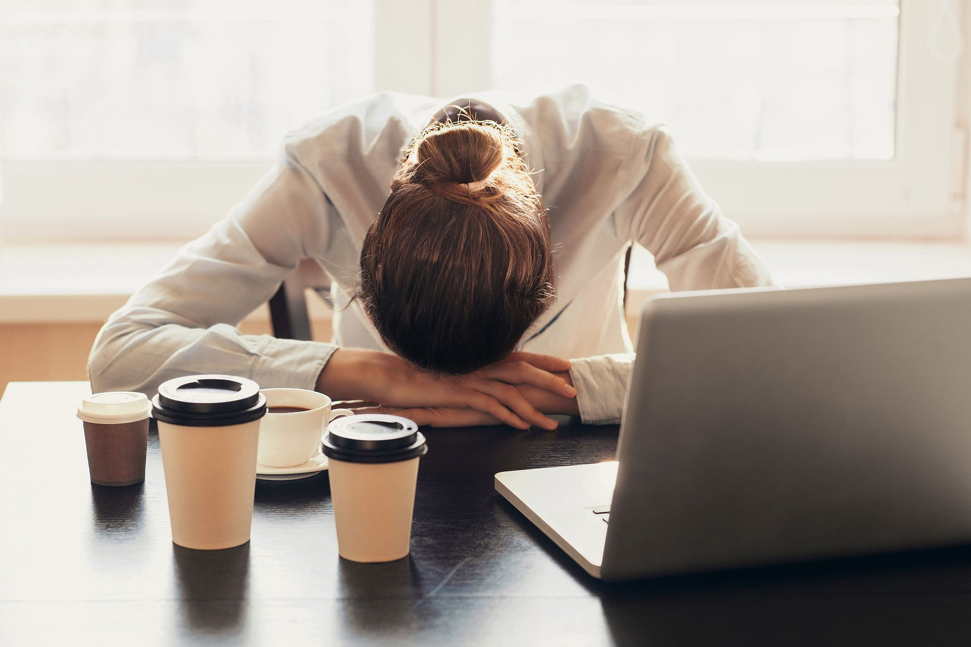
September 2020 “This Could’ve Been Handled Better”
Our classes were changed on us at the last minute, causing major scheduling conflicts and added stress because it was too late to make adjustments.
I purposely scheduled ONLY face-to-face classes because I know I struggle with online formats.
Most classes became split, with half of class in-person and the other half online, then swapping every other class. Some classes just went to fully online.
These changes made it an even bigger nightmare because I was new to the school and had not been given a tour due to Covid, so I didn’t know where anything was on campus.
I went from having a carefully coordinated schedule of all face-to-face classes, having back-to-back schedules with enough time to get from each class to the next- to having scheduling conflicts with literally every class, and having one fully online class.
I had the opposite days for in-person attendance with all my classes that followed each other. It was impossible to find a place on campus to do online classes, so I had 10 minutes to leave class, go home, and log in to my online class. Then after that class I had 10 minutes to return to school for my next in-person class. It was the most stressful semester of my life.

Slide 12
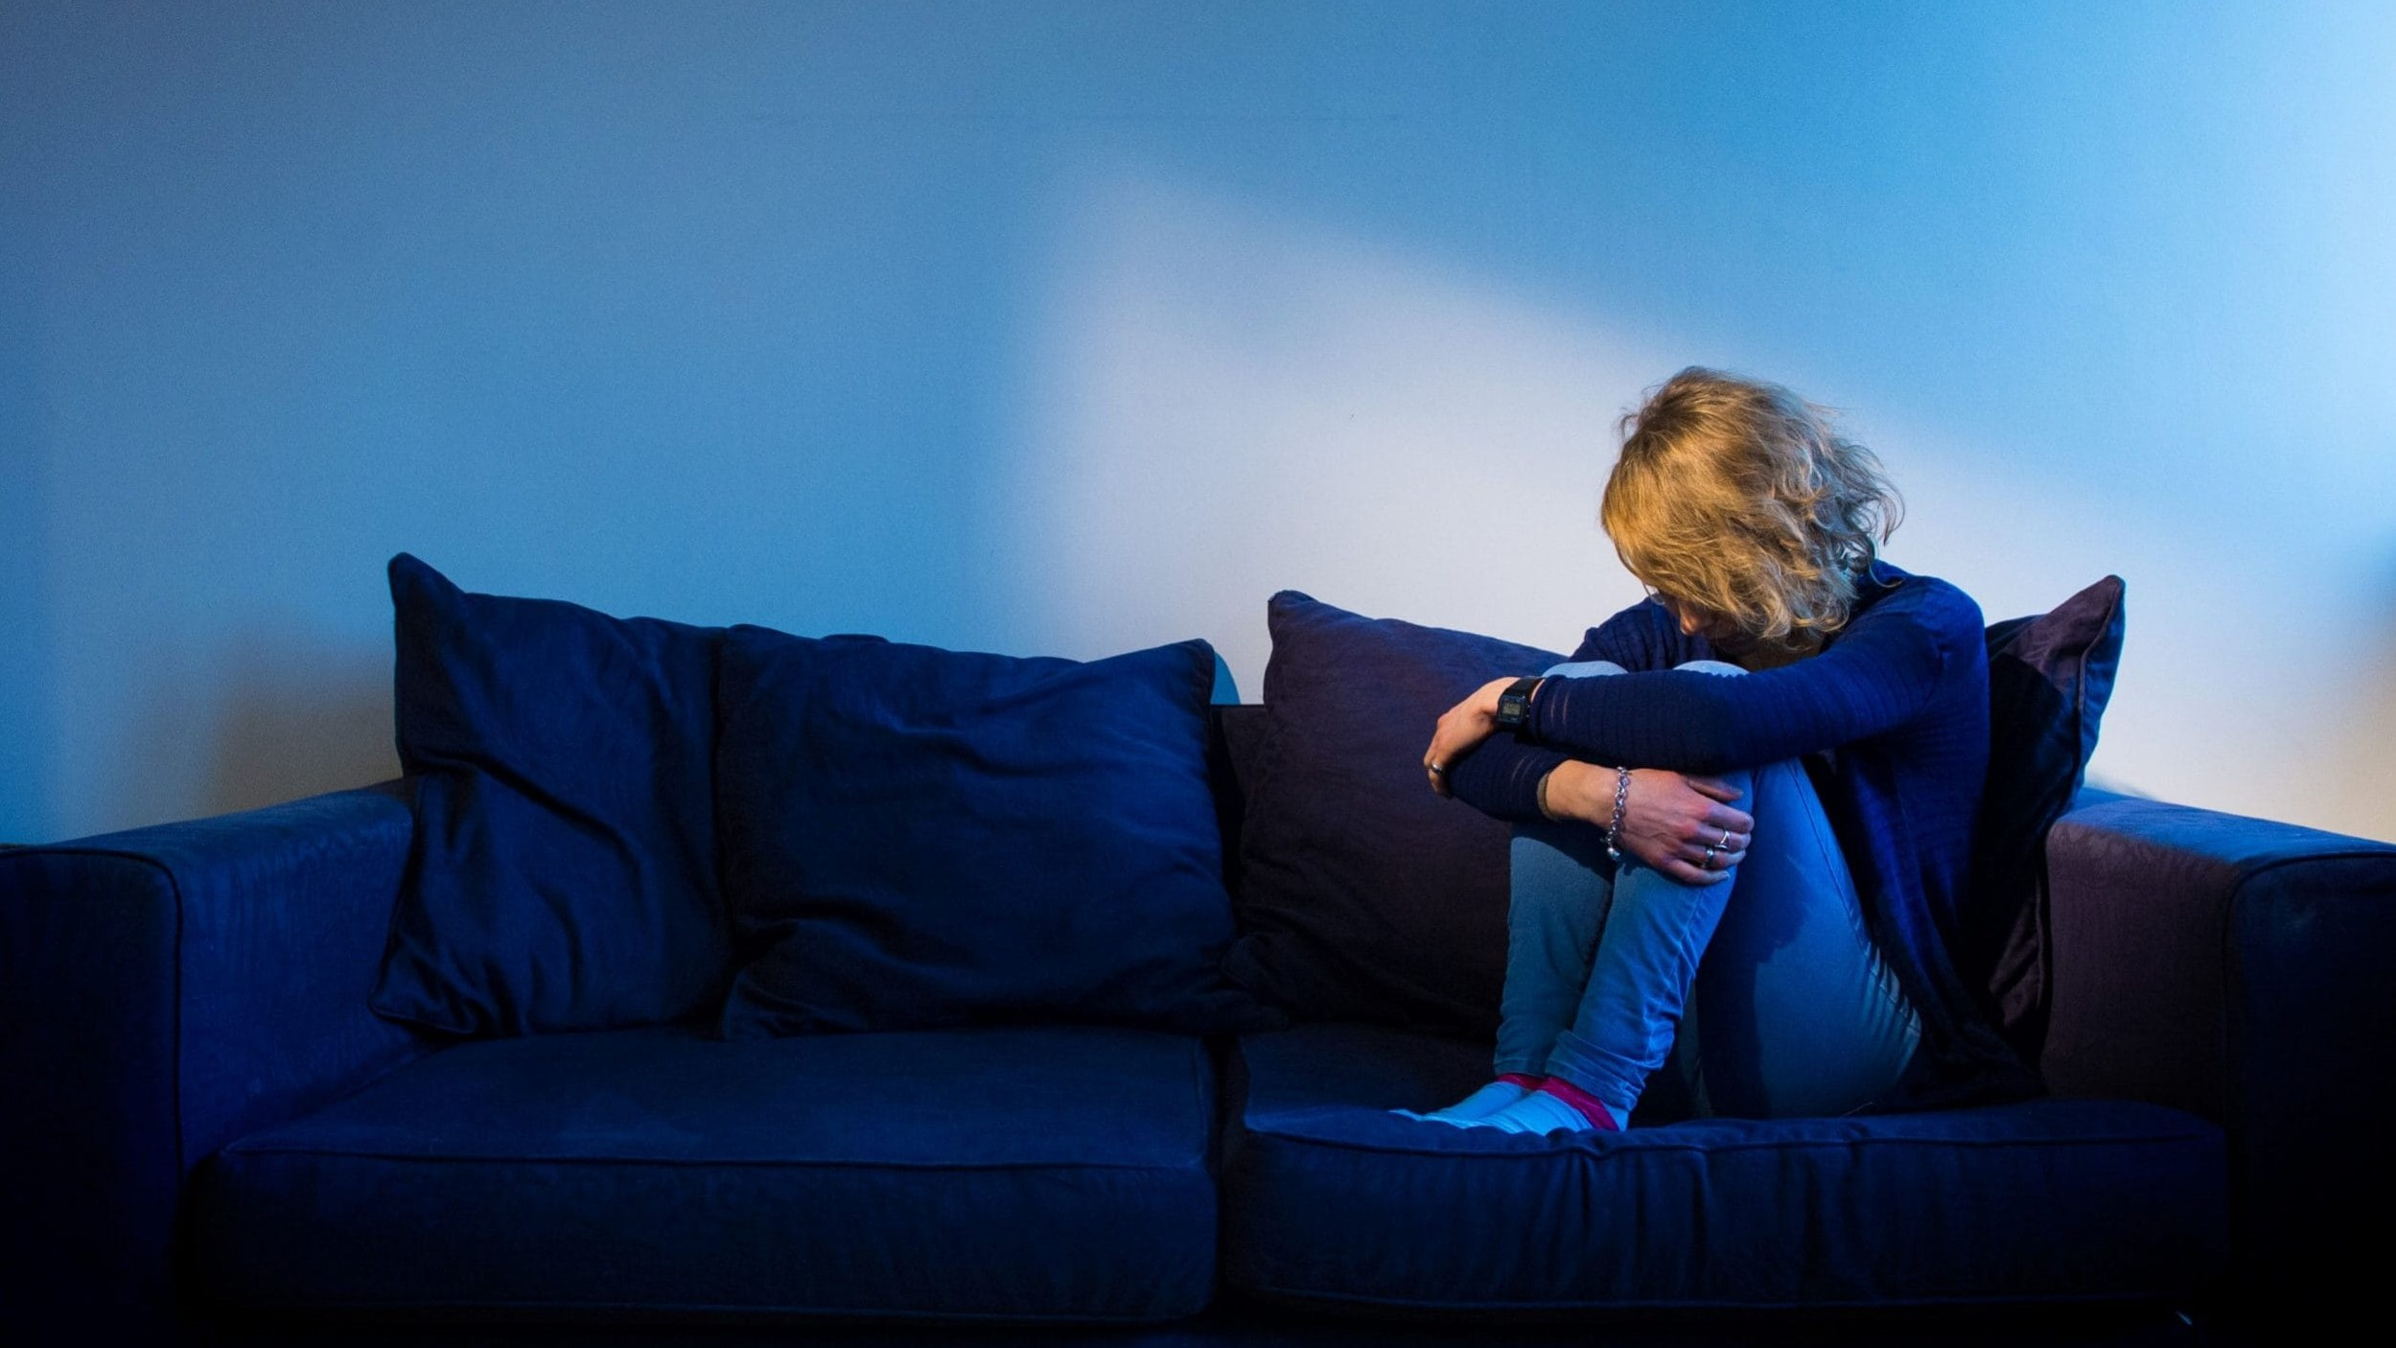
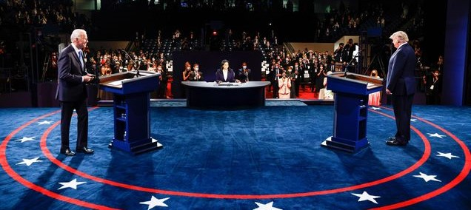
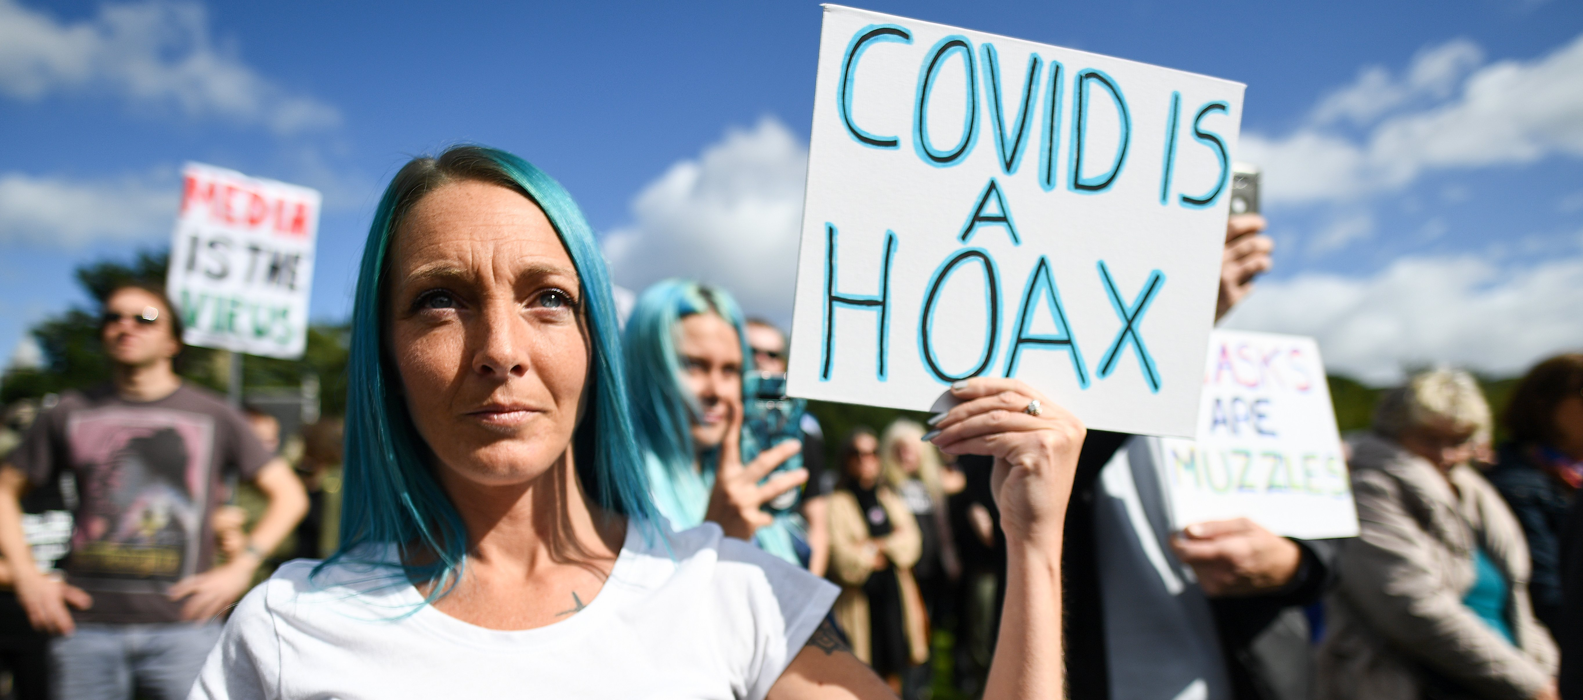
October 2020 “Not a good mix”
In a normal year, this would already be a difficult time of year for me- I have bipolar disorder, so seasonal changes trigger depression- and the mid-semester stress levels from school begin to rise...
But this was not a normal year- This was an election year, with the most polarized campaigns of my lifetime. Everything was highly politicized, especially Covid.
Covid had found it’s way into nearly every aspect of our lives. That was exacerbated by the politicization of Covid & public health, and the polarization of the people. At one end were countless doomsayers spreading fear and panic, while at the other end were masses of conspiracy theorists spreading misinformation and claiming the virus is just a hoax.
Lies and misinformation were more common than the truth, panic was rampant, friends and family were fighting and even disavowing each other... Anger, stress, anxiety, exhaustion- it was chaos.

Slide 13
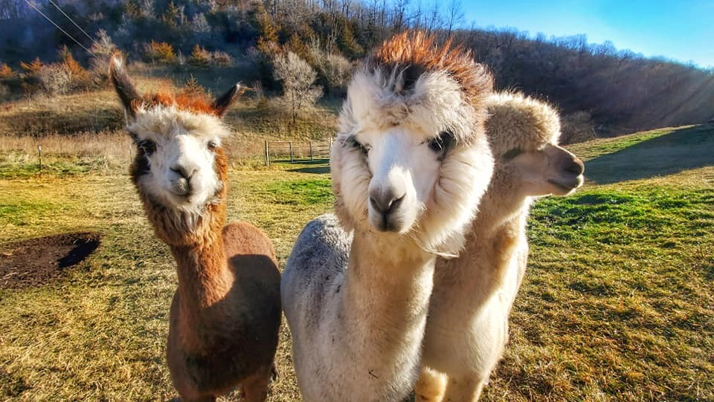
November 2020 “I Need a Break”
I thought things would settle down after the election... I was wrong. Pretty much everything continued from before, but now claims of election fraud were added to the chaos.
Overwhelmed and exhausted, I decided I needed a break and my girlfriend agreed...
So, we rented a cute cabin on a hobby farm and spent Thanksgiving with alpacas and chickens!

Slide 14
December 2020 “Just a Blur”
With so much going on in the world and life, I just started to tune out. The pandemic, politics, social media, school, everything... It all became too much to process, so I tuned out and isolated. I can’t remember much from then, it’s all just a blur.

Slide 15
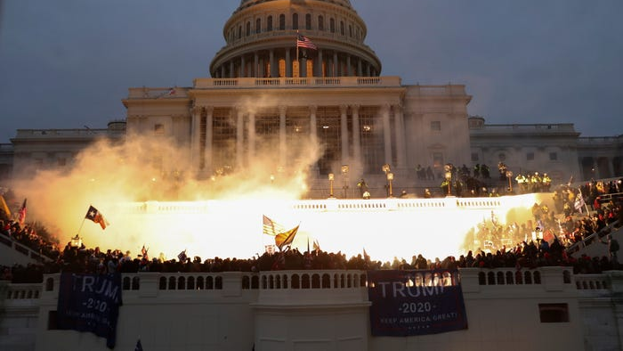
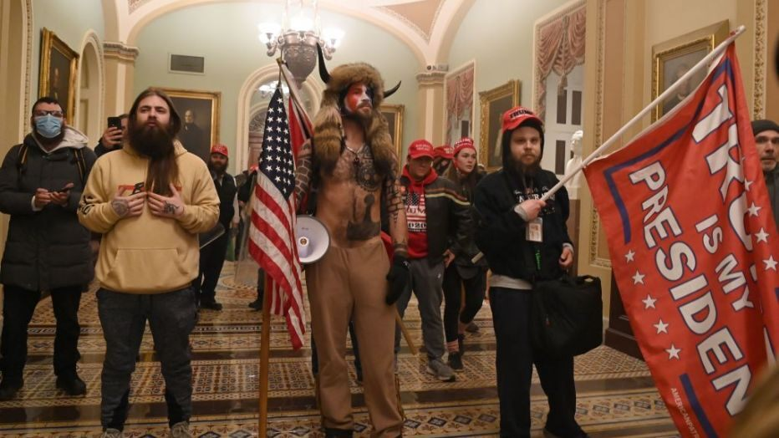
January 2021 “I Don’t Even Care Anymore”
We’re a year into this pandemic. Schools and businesses still have restrictions. President Trump continues to fuel the division in our country. Now we have a riot at our capitol. Thousands of conspiracy cuckoos stormed the capitol, some dressed like they were headed to some sort of 18th century comic book convention. It was tragic, and I knew that, but I didn’t really care anymore. I was too exhausted to care. I had become a zombie, apathetic toward just about everything and doing just enough to survive each day at a time.

Slide 16
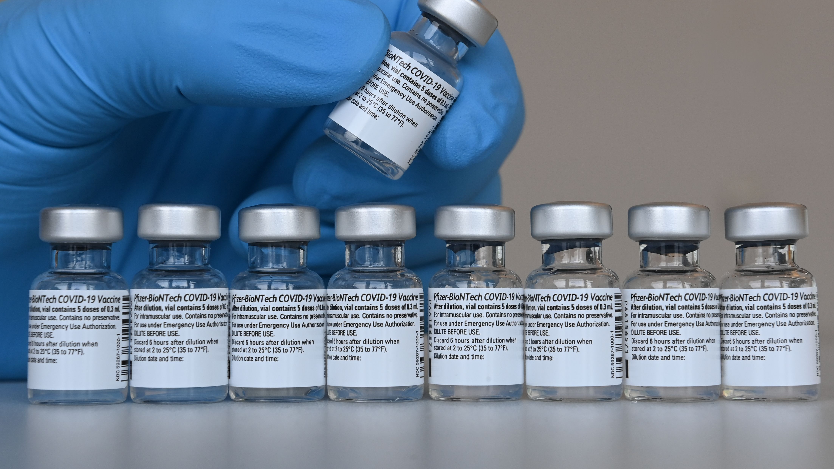
February 2021 “Light in the Tunnel”
There’s finally some light at the end of the tunnel. We have a new president who aims to unite us, rather than divide us, and the vaccine rollout is underway. High-risk persons and healthcare workers have begun receiving their vaccinations, and the general public should be able to get theirs in early spring. I am so ready for Covid to no longer be forced into every aspect of our lives.

Slide 17
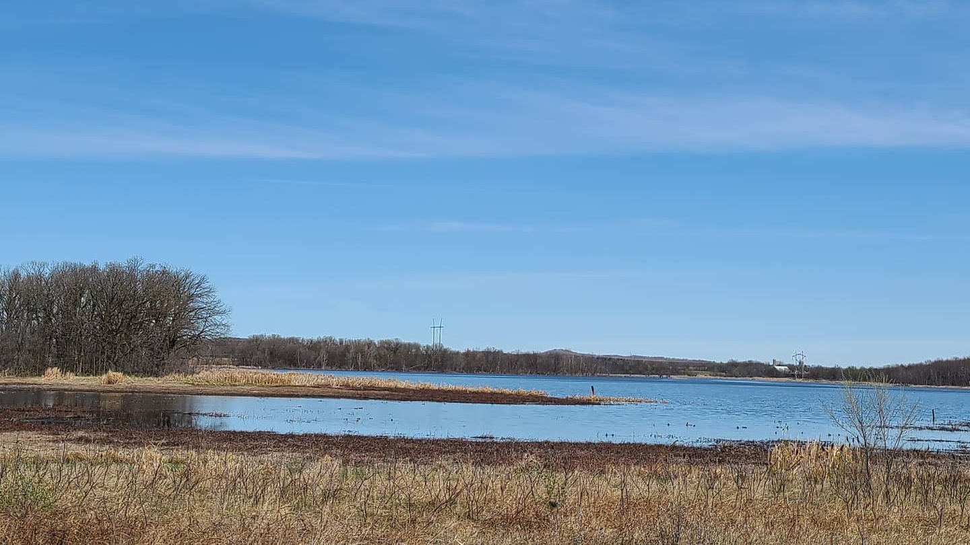
March 2021 “Nice Weather”
School is not going well, and our spring break was cancelled, but the weather has been better. The snow has all melted, the sun has been shining, and the temperature has been unseasonably warm. I’ve enjoyed opening the windows to get some fresh air in my home and taking my dog for walks. There’s not much else to be optimistic about currently because my mental health is in poor condition and I’m struggling with school and finances, but at least I’ve got nice weather.

Slide 18
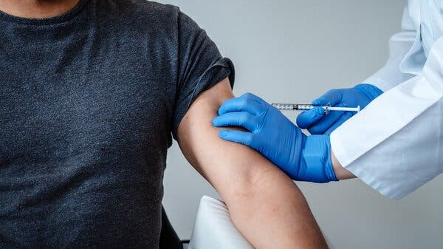
April 2021 “Final Push”
I was able to get fully vaccinated! Yay! Now the general public has begun receiving it also. Hopefully, enough people will get vaccinated so that this pandemic will become under control, and we can finally to get back to normal. I’m running on fumes at this point. School is the most important thing to me, but this year has been awful and I’m barely holding on. I had to withdraw from two classes because my grades were so poor. My remaining classes are not doing so well either, but if I can just finish the last few weeks then I should be able to pass them. I just need to hang on a little longer, then it will be over. Hopefully, after summer break, next school year will be back to normal so I can put this year behind me.

Slide 19
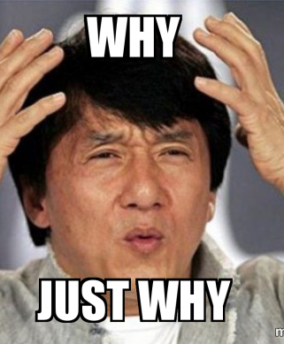
May 2021 “One Last Whirlwind”
...And here come all the time-consuming projects at once, all with multiple parts, and most having confusing guidelines. It’s the end of the semester, which is stressful, but at least I get a break from Covid with my classes. I’ve studied, I know the subject material, I’m ready. A few projects and exams are all that separate me from finishing this semester, putting it behind me, and taking a break from everything school and Covid related.
I wear my mask, I social distance, and I’ve gotten vaccinated. Beyond that, I don’t want to even think about Covid at this point. I turn off the news when they talk about it, I skip past social media posts about it, I avoid conversations about it, I just want a reprieve from it. It has forced its way into almost every aspect of my life and I’m done with it.
Oh wait, nevermind about the Covid reprieve. Half of my classes now have projects specifically about Covid- the very last thing in the world that I want to be talking about, the thing that has found it’s way into every other aspect of my life, Covid- Has now become the subject of my final projects. Why?! Just why?

Slide 20
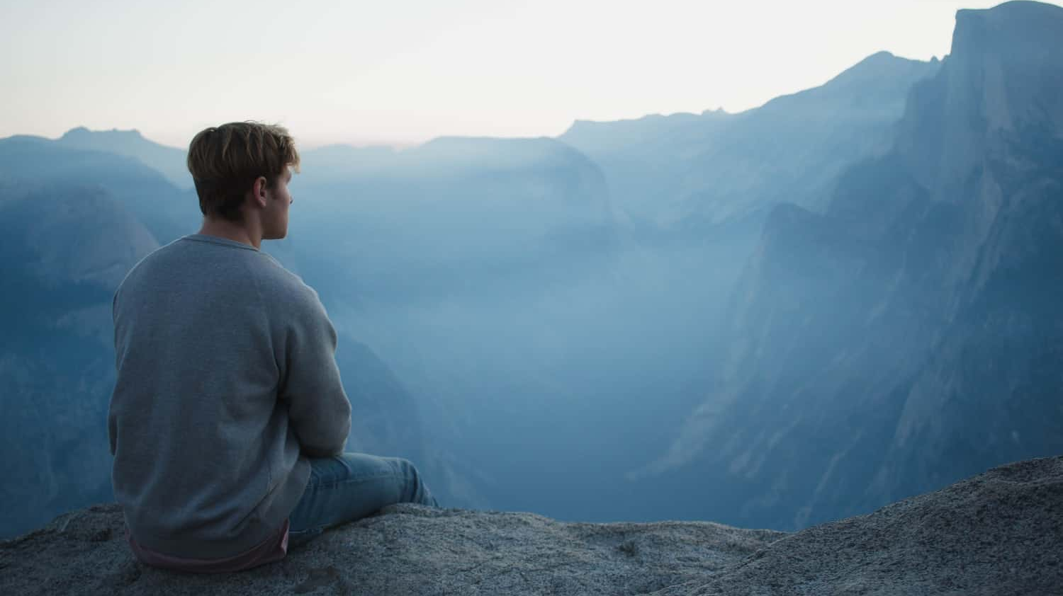
The Future “Clear My Head”
After 18 months of the Covid pandemic...
After losing my entire support system...
After all the isolation and social distance...
After all the political and social chaos in our country...
After the most frustrating and stressful school year ever...
After all the depression and anxiety deteriorating my mental health...
After all the damage done to my academic record...
After losing almost everything I care about...
Now I find myself on the verge of being a college dropout, struggling to pay my bills, and trying to find reasons to go on...
Now I’m just trying to do what I can to survive, and hopefully I can make it through the next few weeks so I can take the summer to just clear my head and start fresh.

