Slide 1
My COVID-19 Experience journal

Slide 2
covid -19 is believed to have started in wuhan, china. from there, it spread rapidly worldwide and impacted millions. Everyone has their own unique story. My name is Karla and I am here to share mine.

Slide 3
March: The start of quarantine
Towards the middle of March, my classes became virtually taught. It was not the easiest transition for me, but I made it work. We all had to make It work. It was the only option.

Slide 4
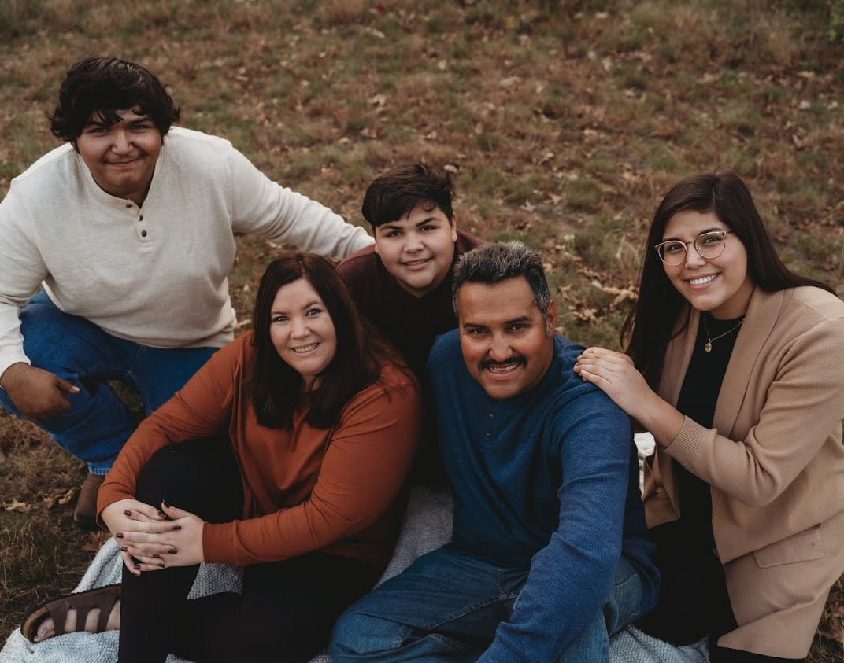
Home sickness and Financial uncertainties
I struggled with the idea of not being able to visit my family as much as I normally did. Video chats certainly helped but were not the same.
My job closed and I was unable to qualify for unemployment and stimulus checks due to being marked as a “dependent.” I still had to pay rent and other bills. Luckily, my family was able to help as much as they could.

Slide 5
Staying Healthy during a pandemic
Once everything started to shut down, people began to panic. Grocery shopping was almost a struggle due to the lack of food available. Some stores had limits on certain food and household items.
I was fortunate enough to have access to fruits and veggies, which allowed my boyfriend and I to master the art of smoothies. On the other hand, finding good quality toilet paper, was not easy.

Slide 6
Keeping your mind happy
Luna
Pepper
Quarantine felt like a prison sentence. With classes being online and not being able to leave the house unless necessary, was very hard at times. Having furry friends most certainly helps!

Slide 7
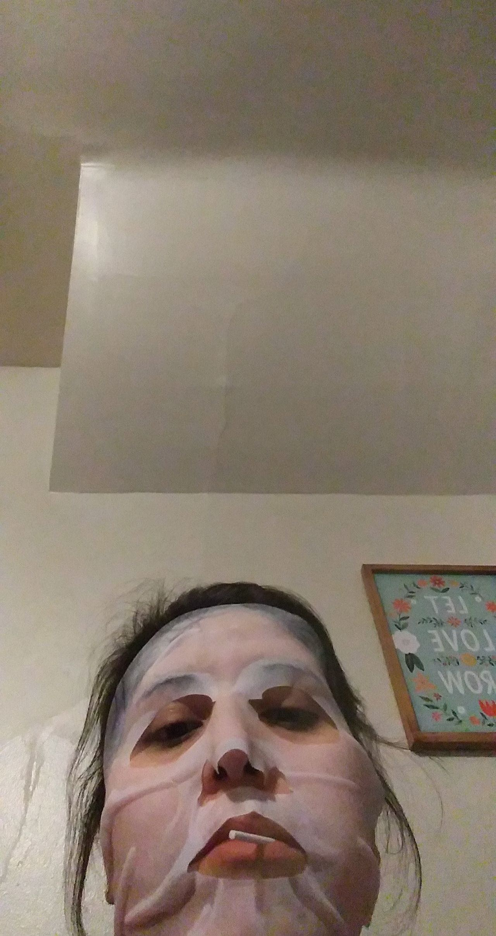
Self care is super important
The pandemic was stressful. There is nothing better than doing a face mask and having a few laughs with loved ones. I also highly recommend ordering a few books, if you don’t do that already. Keeping your mind sharp is a must!

Slide 8
Summer: stores and restaurants begin to slowly open their doors
You have no idea how happy I was once I heard my employer was ready to open their doors! Things were not the same, but I was still grateful for a steady income again.
We had to sanitize after each customer, wear gloves at the register, wear masks at all times, take our temps before work, and remain six feet apart. I suffer from seasonal allergies, and this caused issues because they resembled covid symptoms.

Slide 9
Graduations were postponed
My younger brother worked extremely hard to be able to graduate high school in May of 2020. Due to covid, he was unable to experience the excitement and bittersweet feeling of a ceremony.
Luckily in August he was able to experience it from the safety of the football stadium. This caused him to not be able to have a normal grad party, but we tried our bests to make him feel loved and special during that difficult time.

Slide 10
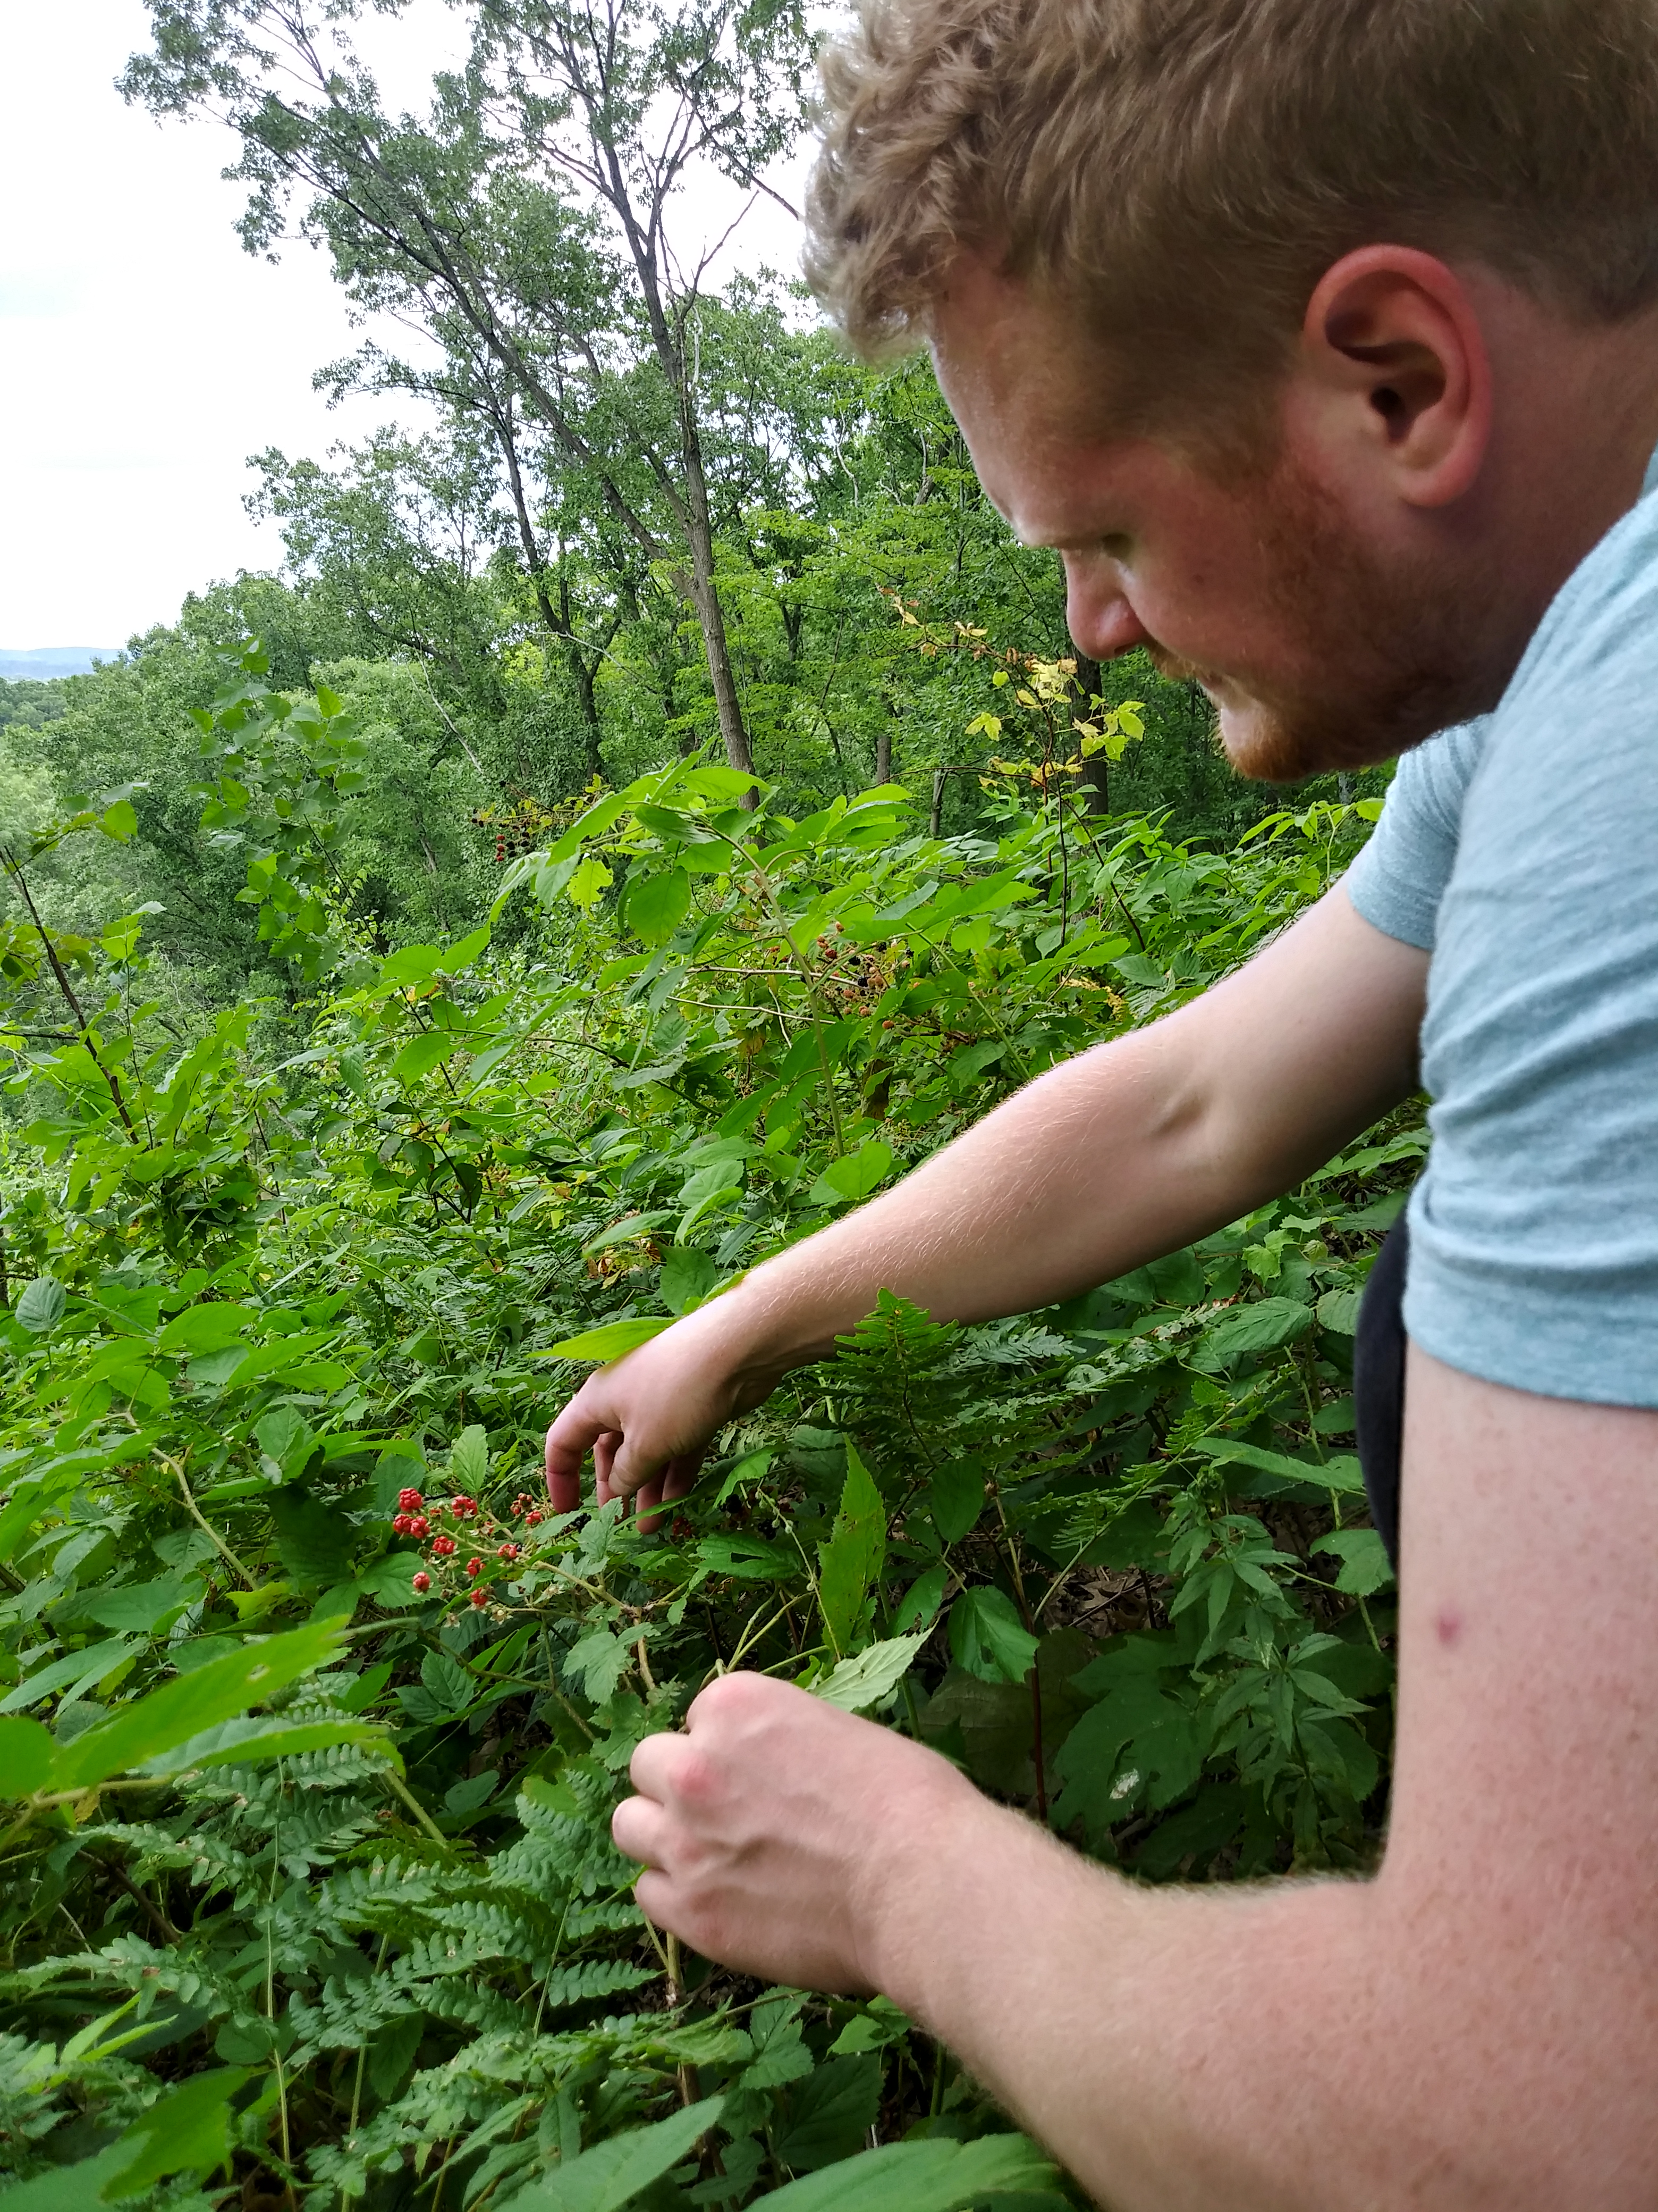
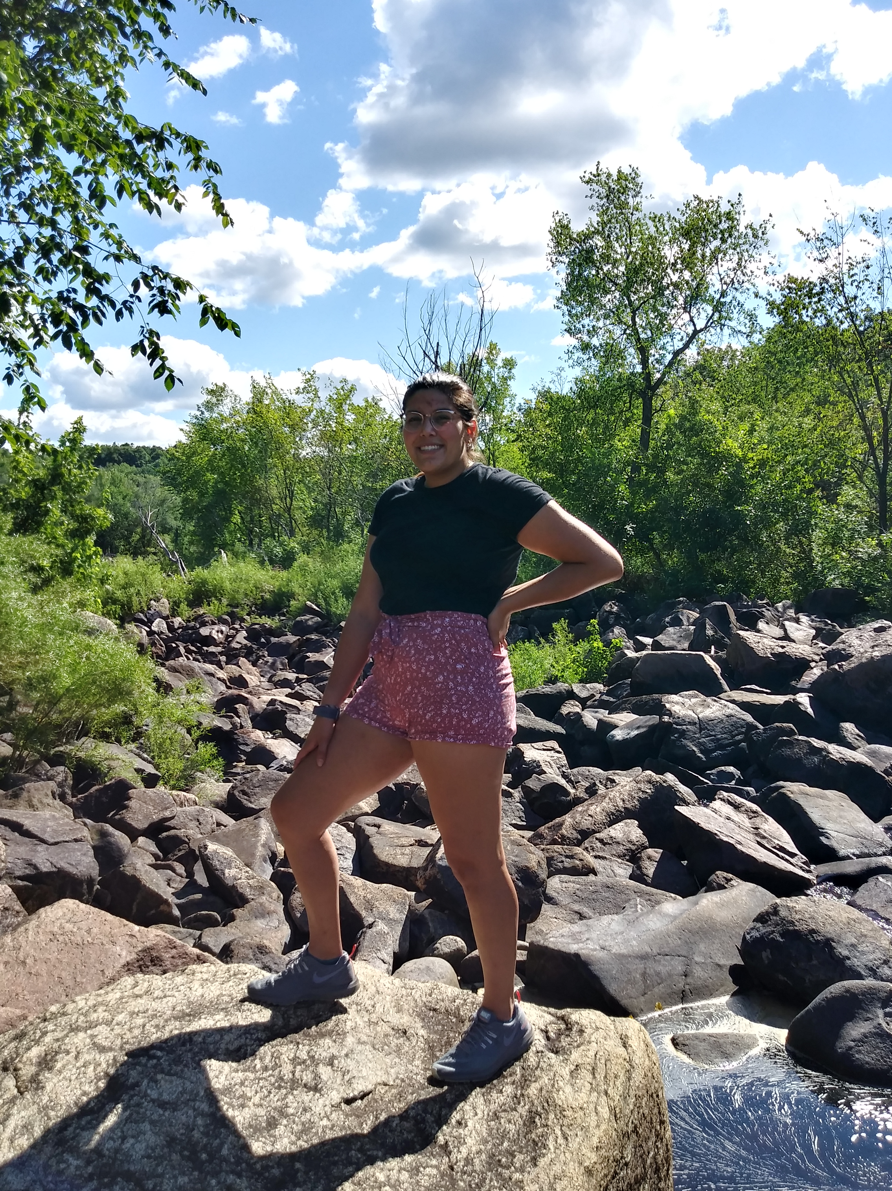
Hiking adventures
My boyfriend and I tried to get out of the house as much as possible. This was not easy because everything was closed. We were fortunate enough to have been able to explore local trails. It felt amazing to get fresh air and truly enjoy nature.
Over the summer I was able to learn how to swim and soak up all the rays!

Slide 11
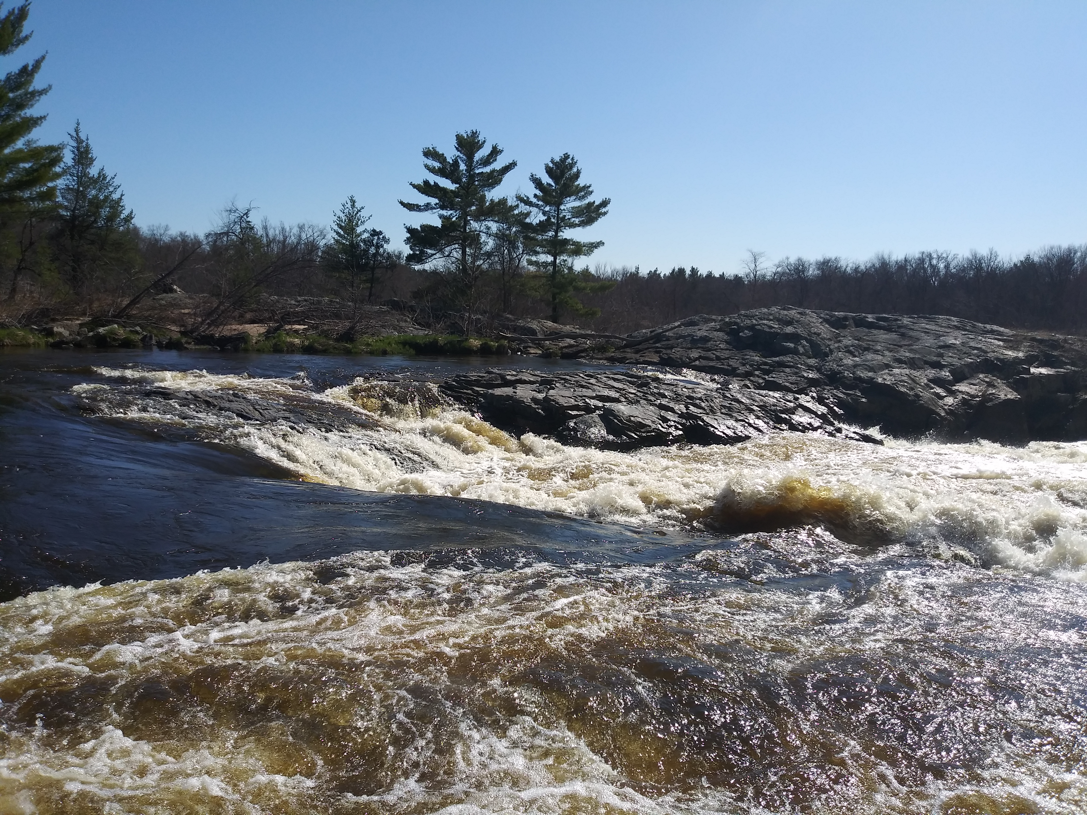
Fall Months
My roommates tested positive for covid and I ended up having to quarantine and miss out on work. Again, I was not able to qualify for unemployment. This was not fun due to being away from my only source of income.
I strongly disliked being stuck inside and not being able to see loved ones for 2+ weeks. It reminded me of when quarantine started for everyone back in the late spring months.
I ended up testing negative and was able to return to work and see loved ones!

Slide 12
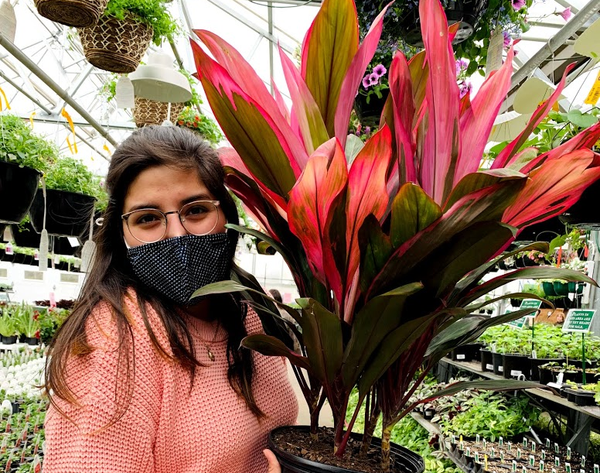
today
C
I am fully vaccinated and currently preparing to graduate with a BA in Latin American Studies. I do feel as if I missed out on my last few semesters due to covid, but I am grateful for the experiences it brought. If the pandemic taught me anything, it was that plants bring happiness.
Thank you for taking the time to read my story. Please stay safe and take care.

